Slide 1

Chapter 9
Modern Asymmetric-Key Ciphers

Slide 2
outlines
Diffie-Hellman Key Exchange.
Knapsack Cryptosystem.
RSA Cryptosystem.
ElGamal Cryptosystem (optional).

Slide 3
Learning objectives
In the end of this Chapter 9, students will be able:
To understand and operate the Diffie-Hellman Key Exchange to establish a common shared secret key.
To understand and operate the knapsack cryptosystem to encrypt and decrypt messages.
To understand and operate the RSA cryptosystem to encrypt and decrypt messages.
To understand and discuss some security issues in the above-mentioned asymmetric-key cryptography.

Slide 4
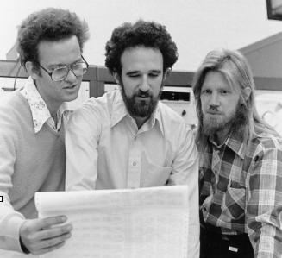
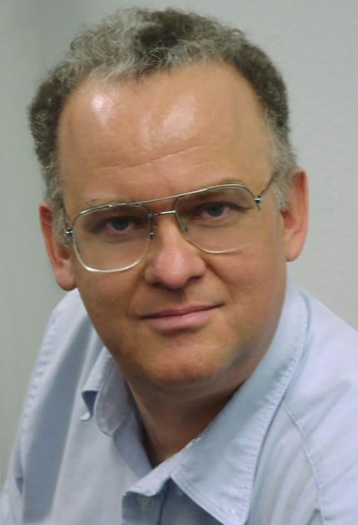

Diffie-hellman key exchange

Slide 5
Diffie-hellman key exchange (dhke)
The birth of first ever public-key cryptography in 1976, thanks to Whitfield Diffie, Martin Hellman and Ralph Merkle.
DHKE resolves the key distribution issue addressed in modern cryptography.
It enables two users to securely exchange a secret key that can be used for subsequent symmetric encryption of messages.
This algorithm limited to the exchange of secret key (no encryption is considered).
The underlying security lies on the difficulty assumption of computing the Discrete Logarithm Problem (DLP) .

Slide 6
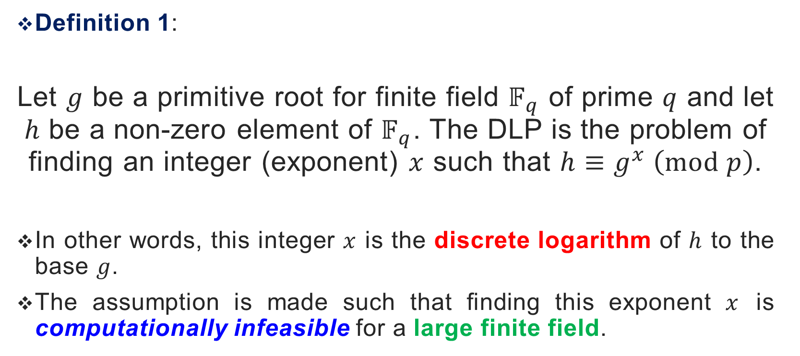
DHKE – THE DLP ASSUMPTION
Definition 1:
Let $g$ be a primitive root for finite field $𝔽_{q}$ of prime $q$ and let $h$ be a non-zero element of $𝔽_{q}$. The DLP is the problem of finding an integer (exponent) $x$ such that $h≡g^{x} \left(mod p\right)$.
In other words, this integer $x$ is the discrete logarithm of $h$ to the base $g$.
The assumption is made such that finding this exponent $x$ is computationally infeasible for a large finite field.

Slide 7
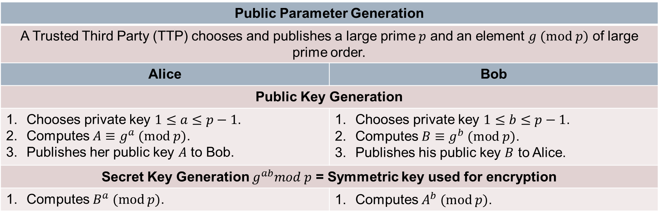

DHKE – ALGORITHM
Public Parameter Generation
A Trusted Third Party (TTP) chooses and publishes a large prime $p$ and an element $g (mod p)$ of large prime order.
Alice | Bob
Public Key Generation
Chooses private key $1≤a≤p−1$. Computes $A≡g^{a} (mod p)$. Publishes her public key $A$ to Bob. | Chooses private key $1≤b≤p−1$. Computes $B≡g^{b} (mod p)$. Publishes his public key $B$ to Alice.
Secret Key Generation $g^{ab}mod p$ = Symmetric key used for encryption
Computes $B^{a} (mod p)$. | Computes $A^{b} (mod p)$.
The shared private key computed is correct since:
$$B^{a} \left(mod p\right)≡{\left(g^{b}\right)}^{a}≡{\left(g^{a}\right)}^{b}≡A^{b}\left(mod p\right)$$

Slide 8
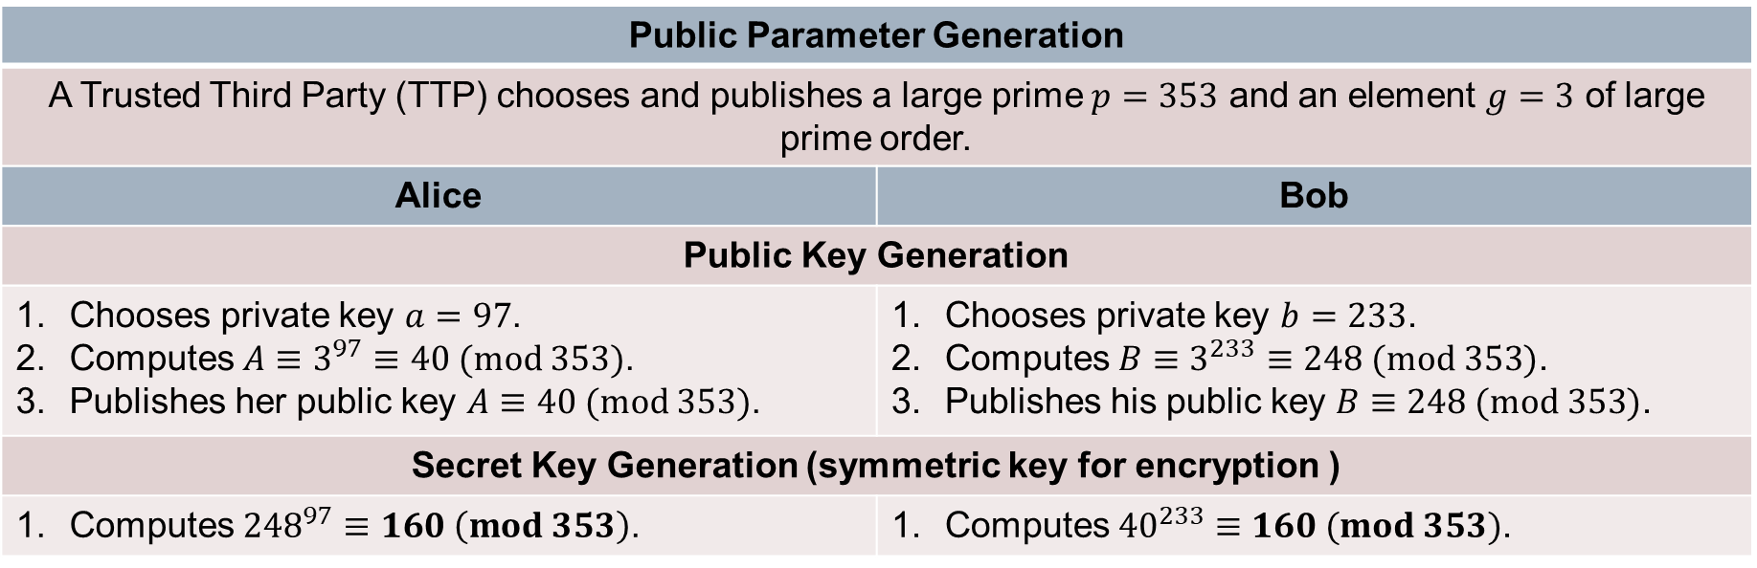


DHKE – An Example
Public Parameter Generation
A Trusted Third Party (TTP) chooses and publishes a large prime $p=353$ and an element $g=3$ of large prime order.
Alice | Bob
Public Key Generation
Chooses private key $a=97$. Computes $A≡3^{97}≡40 (mod 353)$. Publishes her public key $A≡40 (mod 353)$. | Chooses private key $b=233$. Computes $B≡3^{233}≡248 (mod 353)$. Publishes his public key $B≡248 (mod 353)\text{.}$
Secret Key Generation (symmetric key for encryption )
Computes ${248}^{97}≡160 \left(mod 353\right)$. | Computes ${40}^{233}≡160 (mod 353)$.
If an attacker captures the public key $A$ or $B$, he needs to find out the private keys $a$ or $b$ that generates them. This is indeed the DLP.
$${248}^{97}≡{40}^{233}$$
$${(3)}^{(233)97}≡{(3)}^{(97)(233)}$$

Slide 9
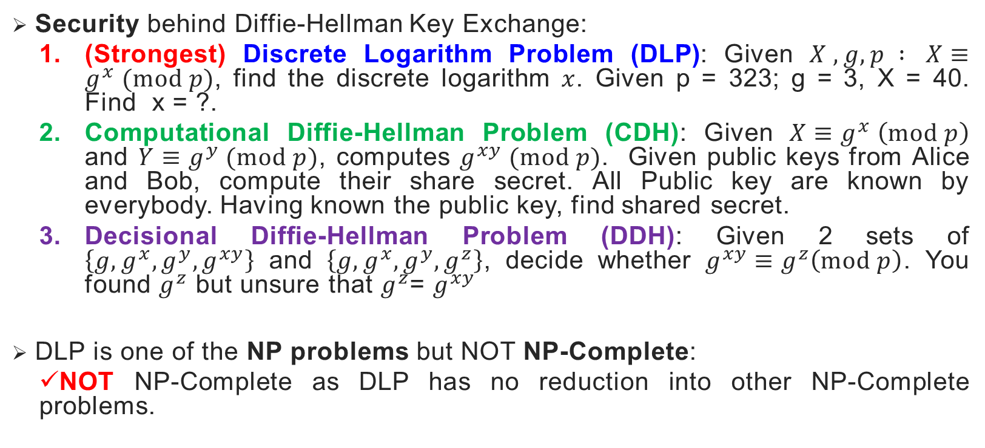
DHKE – security
139751
Security behind Diffie-Hellman Key Exchange:
(Strongest) Discrete Logarithm Problem (DLP): Given $X , g, p : X≡g^{x} (mod p)$, find the discrete logarithm $x$. Given p = 323; g = 3, X = 40. Find x = ?.
Computational Diffie-Hellman Problem (CDH): Given $X≡g^{x} \left(mod p\right)$ and $Y≡g^{y} (mod p)$, computes $g^{xy} (mod p)$. Given public keys from Alice and Bob, compute their share secret. All Public key are known by everybody. Having known the public key, find shared secret.
Decisional Diffie-Hellman Problem (DDH): Given 2 sets of $\left\{g,g^{x},g^{y},g^{xy}\right\}$ and $\left\{g,g^{x},g^{y},g^{z}\right\}$, decide whether $g^{xy}≡g^{z}\left(mod p\right)$. You found $g^{z}$ but unsure that $g^{z}$= $g^{xy}$
DLP is one of the NP problems but NOT NP-Complete:
NOT NP-Complete as DLP has no reduction into other NP-Complete problems.

Slide 10
DHKE – security issue
Although the idea is brilliant, unfortunately the basic version of DHKE suffers from the Man-in-the-Middle (MITM) attack.
Reason: DHKE protocol DOES NOT authenticate the users.
Solution: The MITM in DHKE can be resolved using additional digital signature and public-key certificates.
In the next few slides, the demonstration on how MITM is possible in DHKE is outlined.

Slide 11
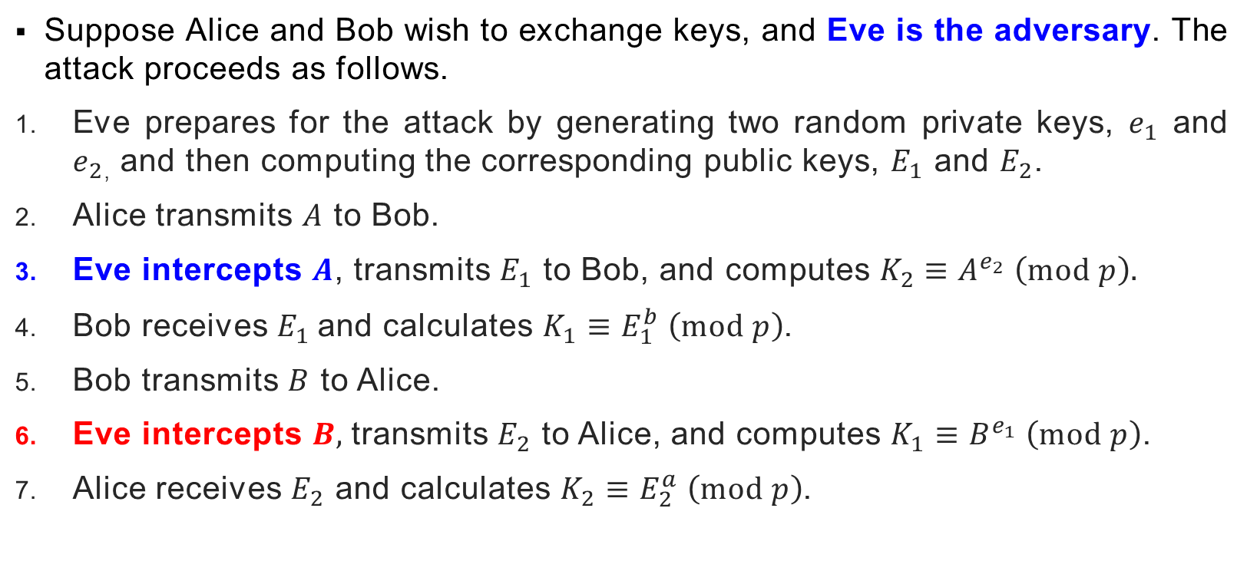
DHKE – man-in-the-middle attack
Suppose Alice and Bob wish to exchange keys, and Eve is the adversary. The attack proceeds as follows.
Eve prepares for the attack by generating two random private keys, $e_{1}$ and $e_{2}$, and then computing the corresponding public keys, $E_{1}$ and $E_{2}$.
Alice transmits $A$ to Bob.
Eve intercepts $A$, transmits $E_{1}$ to Bob, and computes $K_{2}≡A^{e_{2}} \left(mod p\right).$
Bob receives $E_{1}$ and calculates $K_{1}≡E_{1}^{b} \left(mod p\right)$.
Bob transmits $B$ to Alice.
Eve intercepts $B,$transmits $E_{2}$ to Alice, and computes $K_{1}≡B^{e_{1}} \left(mod p\right)$.
Alice receives $E_{2}$ and calculates $K_{2}≡E_{2}^{a} \left(mod p\right)$.

Slide 12
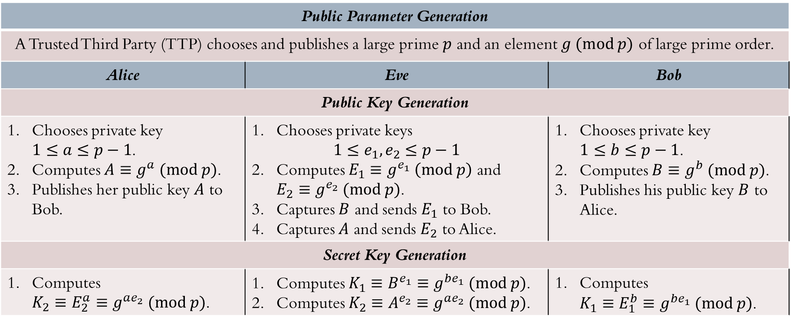
DHKE – man-in-the-middle attack
Eve pretend to be Bob for Alice.
Eve pretend to be Alice for Bob.
Eve does the DHKE 2x.
Public Parameter Generation
A Trusted Third Party (TTP) chooses and publishes a large prime $p$ and an element $g (mod p)$ of large prime order.
Alice | Eve | Bob
Public Key Generation
Chooses private key $1≤a≤p−1$. Computes $A≡g^{a} (mod p)$. Publishes her public key $A$ to Bob. | Chooses private keys $1≤e_{1},e_{2}≤p−1$ Computes $E_{1}≡g^{e_{1}} \left(mod p\right)$ and $E_{2}≡g^{e_{2}} (mod p)$. Captures $B$ and sends $E_{1}$ to Bob. Captures $A$ and sends $E_{2}$ to Alice. | Chooses private key $1≤b≤p−1$. Computes $B≡g^{b} (mod p)$. Publishes his public key $B$ to Alice.
Secret Key Generation
Computes $K_{2}≡E_{2}^{a}≡g^{ae_{2}} (mod p)$. | Computes $K_{1}≡B^{e_{1}}≡g^{be_{1}} (mod p)$. Computes $K_{2}≡A^{e_{2}}≡g^{ae_{2}} (mod p)$. | Computes $K_{1}≡E_{1}^{b}≡g^{be_{1}} (mod p)$.

Slide 13
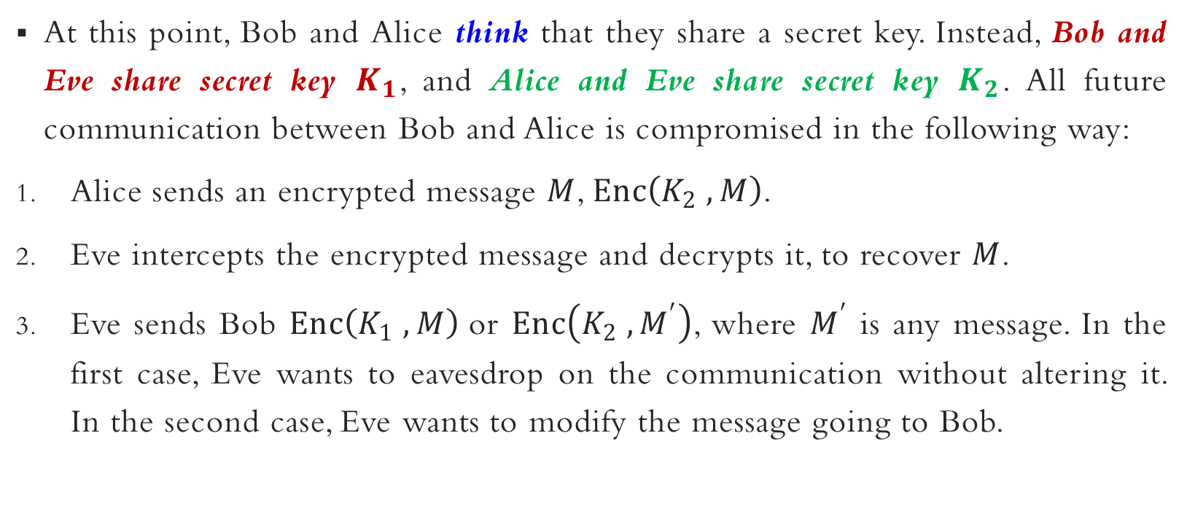
DHKE – man-in-the-middle attack
At this point, Bob and Alice think that they share a secret key. Instead, Bob and Eve share secret key $K_{1}$, and Alice and Eve share secret key $K_{2}$. All future communication between Bob and Alice is compromised in the following way:
Alice sends an encrypted message $M$, $Enc\left(K_{2} ,M\right)$.
Eve intercepts the encrypted message and decrypts it, to recover $M$.
Eve sends Bob $Enc\left(K_{1} ,M\right)$or $Enc\left(K_{2} ,M^{′}\right)$, where $M^{′}$ is any message. In the first case, Eve wants to eavesdrop on the communication without altering it. In the second case, Eve wants to modify the message going to Bob.

Slide 14
Knapsack cryptosystem

Slide 15
Knapsack cryptosystem
One of the earliest public-key cryptosystems for encryption in 1978 proposed by Ralph Merkle and Martin Hellman after the birth of DHKE.
The fundamental primitive of Knapsack cryptosystem is based on the 0/1 knapsack problem, an example of the combinational optimization problem.

Slide 16

Knapsack problem
Definition 2:
Given $N$ items where each has some weights $w_{i}$ and value $v_{i}$ associated with it. Given a knapsack with capacity $W$. The target is to maximize the items into the knapsack such that the sum of values associated with them is the maximum possible.
Mathematically,
$$\sum_{i=1}^{N}{v_{i}x_{i}}≤W, where x_{i}∈\left\{0,1\right\}$$

Slide 17
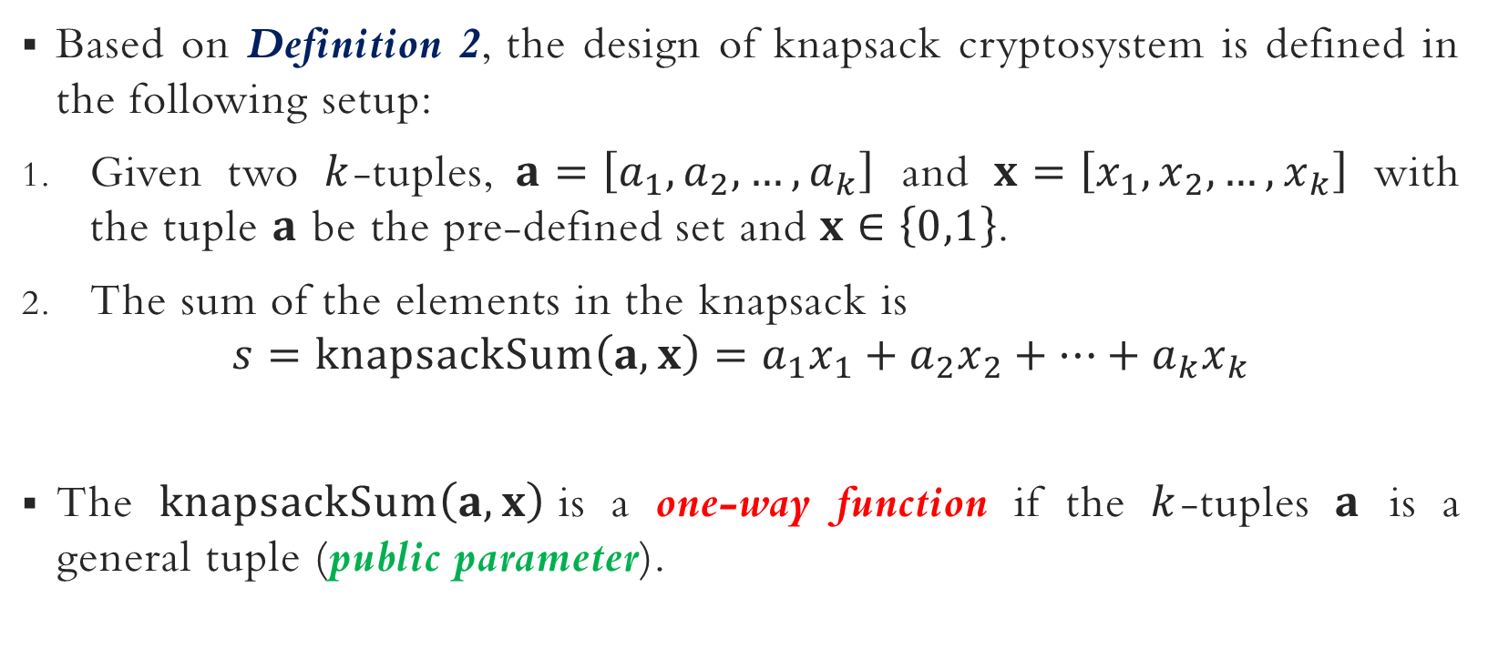
Knapsack function – setup
Based on Definition 2, the design of knapsack cryptosystem is defined in the following setup:
Given two $k$-tuples, $a=\left[a_{1},a_{2},…,a_{k}\right]$ and $x=\left[x_{1},x_{2},…,x_{k}\right]$ with the tuple $a$ be the pre-defined set and $x∈\left\{0,1\right\}$.
The sum of the elements in the knapsack is
$$s=knapsackSum\left(a,x\right)=a_{1}x_{1}+a_{2}x_{2}+…+a_{k}x_{k}$$
The $knapsackSum\left(a,x\right)$is a one-way function if the $k$-tuples $a$ is a general tuple (public parameter).

Slide 18
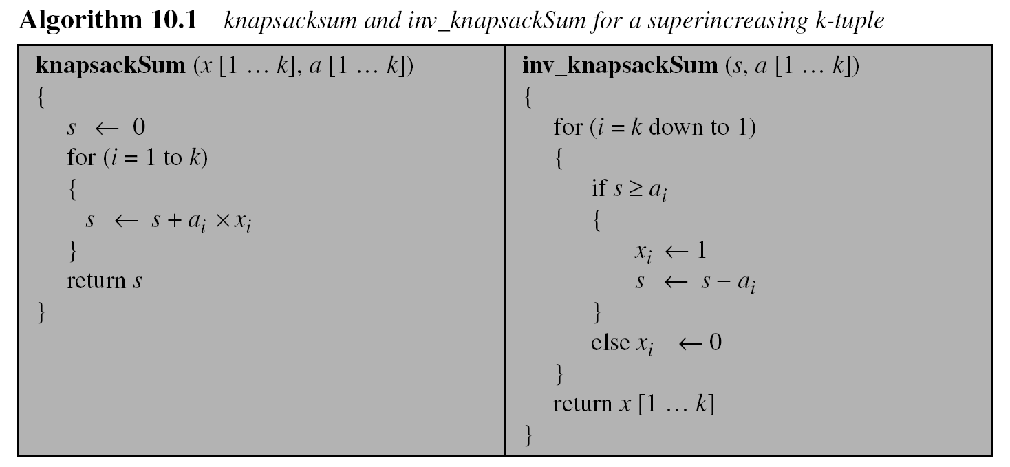
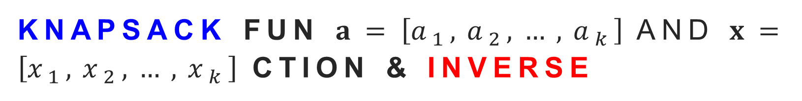


Knapsack fun $a=\left[a_{1},a_{2},…,a_{k}\right]$ and $x=\left[x_{1},x_{2},…,x_{k}\right]$ ction & inverse
U have S, a, k
Find x
$a=\left[a_{1},a_{2},…,a_{k}\right]$ and $x=\left[x_{1},x_{2},…,x_{k}\right]$
U have x, a, k
Find S
$a=\left[a_{1},a_{2},…,a_{k}\right]$ and $x=\left[x_{1},x_{2},…,x_{k}\right]$

Slide 19
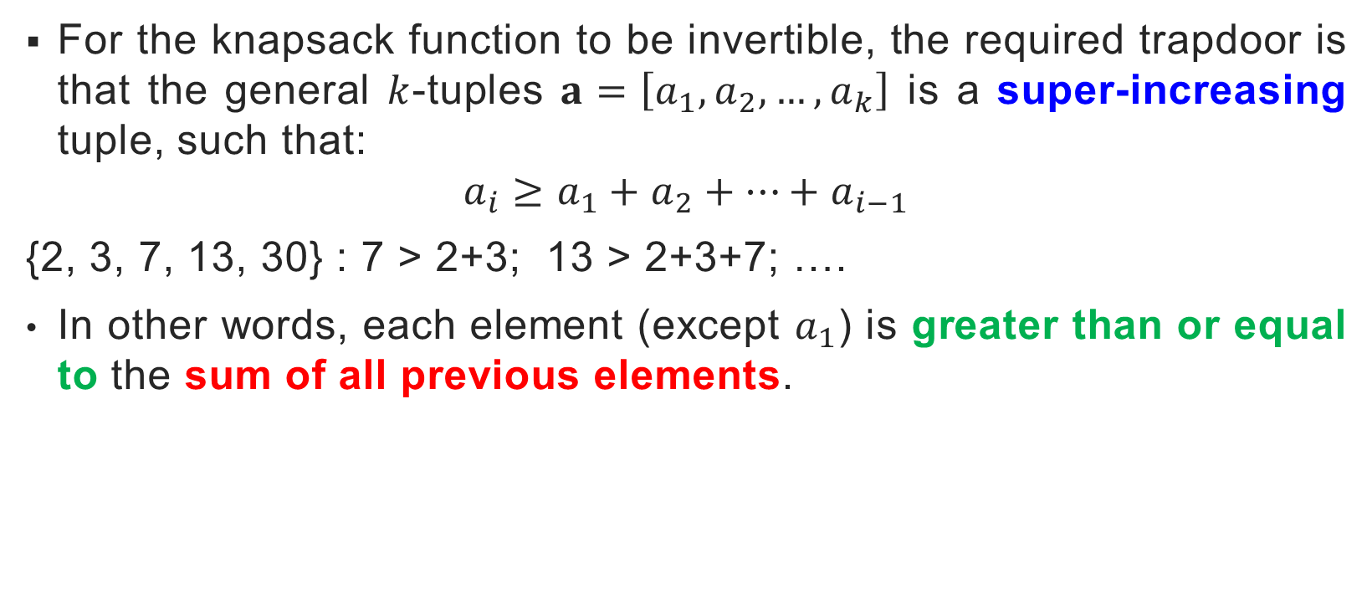
Knapsack function & inverse
For the knapsack function to be invertible, the required trapdoor is that the general $k$-tuples $a=\left[a_{1},a_{2},…,a_{k}\right]$ is a super-increasing tuple, such that:
$$a_{i}≥a_{1}+a_{2}+…+a_{i−1}$$
{2, 3, 7, 13, 30} : 7 > 2+3; 13 > 2+3+7; ….
In other words, each element (except $a_{1}$) is greater than or equal to the sum of all previous elements.

Slide 20
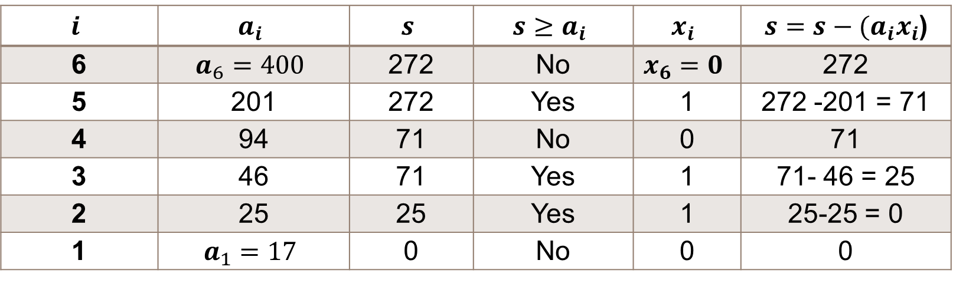

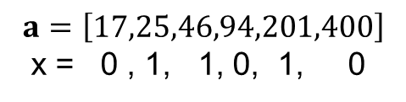
Knapsack function & inverse
$$a=\left[17,25,46,94,201,400\right]$$
x = 0 , 1, 1, 0, 1, 0
Example 1: Given tuple $a=\left[17,25,46,94,201,400\right]$ and $s=272$. Find the tuple $x$ such that $s=ax$ using the $inv_knapsackSum$ algorithm.
Intuitively , 272 = 201 + 46 + 25
The solution $x=\left[0,1,1,0,1,0\right]$, and $a=\left[25,46,201\right]$ are in the knapsack.
272 =25+46 + 201
$$i$$ | $$a_{i}$$ | $$s$$ | $$s≥a_{i}$$ | $$x_{i}$$ | $s=s−(a_{i}x_{i}$)
6 | $$a_{6}=400$$ | 272 | No | $$x_{6}=0$$ | 272
5 | 201 | 272 | Yes | 1 | 272 -201 = 71
4 | 94 | 71 | No | 0 | 71
3 | 46 | 71 | Yes | 1 | 71- 46 = 25
2 | 25 | 25 | Yes | 1 | 25-25 = 0
1 | $$a_{1}=17$$ | 0 | No | 0 | 0

Slide 21
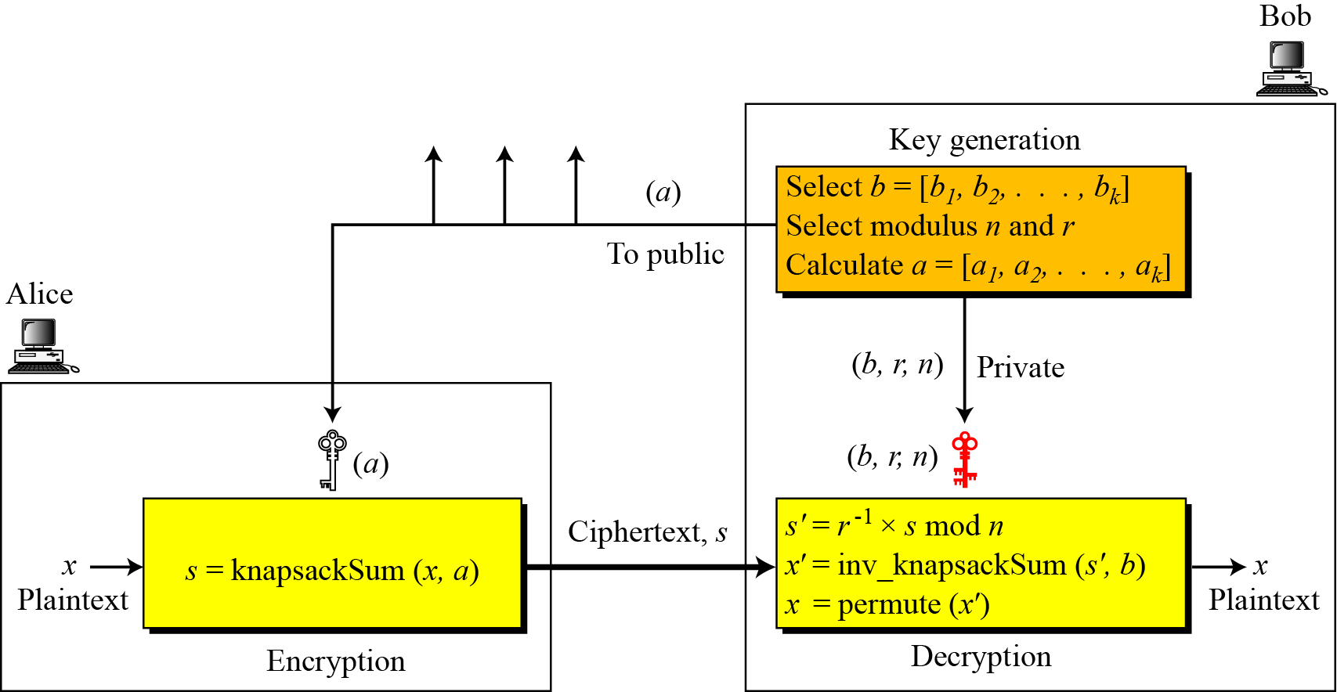
Knapsack cryptosystem – overview

Slide 22
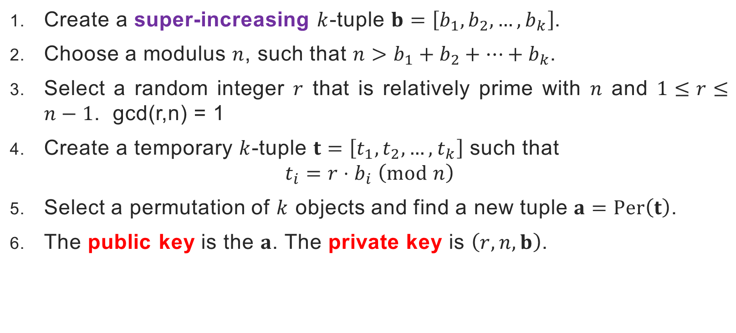
Knapsack cryptosystem – key generation
Create a super-increasing $k$-tuple $b=\left[b_{1},b_{2},…,b_{k}\right]$.
Choose a modulus $n$, such that $n>b_{1}+b_{2}+…+b_{k}$.
Select a random integer $r$ that is relatively prime with $n$ and $1≤r≤n−1$. gcd(r,n) = 1
Create a temporary $k$-tuple $t=\left[t_{1},t_{2},…,t_{k}\right]$ such that $t_{i}=r⋅b_{i} \left(mod n\right)$
Select a permutation of $k$ objects and find a new tuple $a=Per\left(t\right)$.
The public key is the $a$. The private key is $\left(r,n,b\right)$.

Slide 23

Knapsack cryptosystem – encryption
Suppose Alice wishes to send a message to Bob:
Alice converts her message to a $k$-tuple $x=\left[x_{1},x_{2},…,x_{k}\right]$ in which $x_{1}$ is either 0 or 1. The tuple $x$is the plaintext.
Alice uses the $knapsackSum$ algorithm to calculate $s$. She then sends the value of $s$ as the ciphertext.

Slide 24

Knapsack cryptosystem – decryption
Bob receives the ciphertext $s$.
Bob calculates $s^{′}=r^{−1}⋅s \left(mod n\right)$.
Bob uses $inv_knapsackSum$ algorithm to create $x^{′}$.
Bob permutes $x^{′}$ to find $x$. The tuple $x$ is the recovered plaintext.

Slide 25
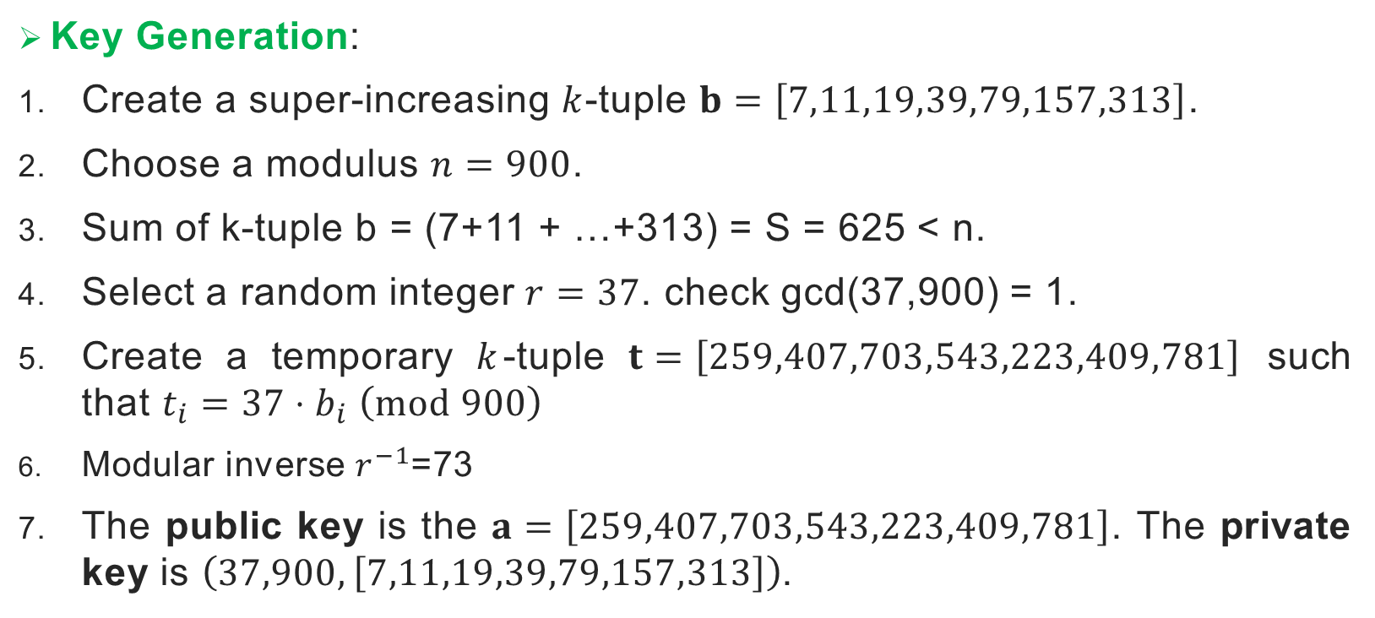
Knapsack cryptosystem – example
37*7 = 259, 37*11 = 407, 37*19 = 703,….,(37*313)mod900 = 781
Key Generation:
Create a super-increasing $k$-tuple $b=\left[7,11,19,39,79,157,313\right]$.
Choose a modulus $n=900$.
Sum of k-tuple b = (7+11 + …+313) = S = 625 < n.
Select a random integer $r=37$. check gcd(37,900) = 1.
Create a temporary $k$-tuple $t=\left[259,407,703,543,223,409,781\right]$ such that $t_{i}=37⋅b_{i} \left(mod 900\right)$
Modular inverse $r^{−1}$=73
The public key is the $a=\left[259,407,703,543,223,409,781\right]$. The private key is $\left(37,900,\left[7,11,19,39,79,157,313\right]\right)$.

Slide 26
Inverse of 37 in Z900
find inverse of 37 in Z900. 1 = 37x + 900y EEA 900 = 37(24) + 12 12 = 900 - 37(24) eq 1 37 = 12(3) + 1 ; 1 = 37 - 12(3) eq 2 12 = 1(12) + 0. gcd(37,900) = 1 1 = 37 - 12(3) 1 = 37 - [900 - 37(24)]3 1 = 37 - 3(900) + 72(37) 1 = 37(73) + 900(-3) match with 1 = 37(x) + 900(y) x = 73 inverse of 37 is 73 Proof 37*73 mod 900 = 2701 mod 900 = 1.

Slide 27
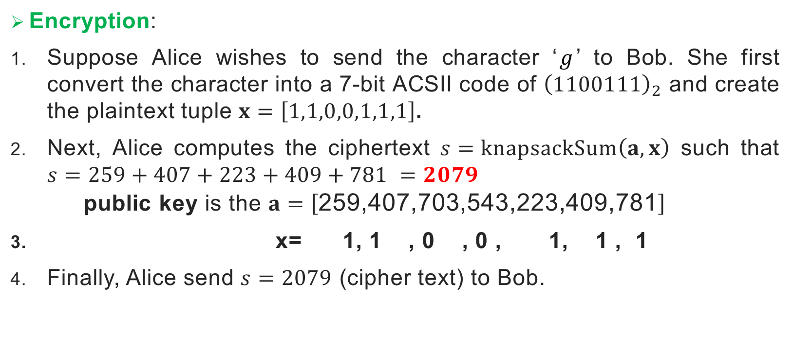
Knapsack cryptosystem – example
Encryption:
Suppose Alice wishes to send the character ‘$g$’ to Bob. She first convert the character into a 7-bit ACSII code of ${\left(1100111\right)}_{2}$ and create the plaintext tuple $x=\left[1,1,0,0,1,1,1\right]$.
Next, Alice computes the ciphertext $s=knapsackSum\left(a,x\right)$ such that $s=259+407+223+409+781 =2079$ public key is the $a=\left[\text{259,407,703,543,223,409,781}\right]$
x= 1, 1 , 0 , 0 , 1, 1 , 1
Finally, Alice send $s=2079$ (cipher text) to Bob.

Slide 28
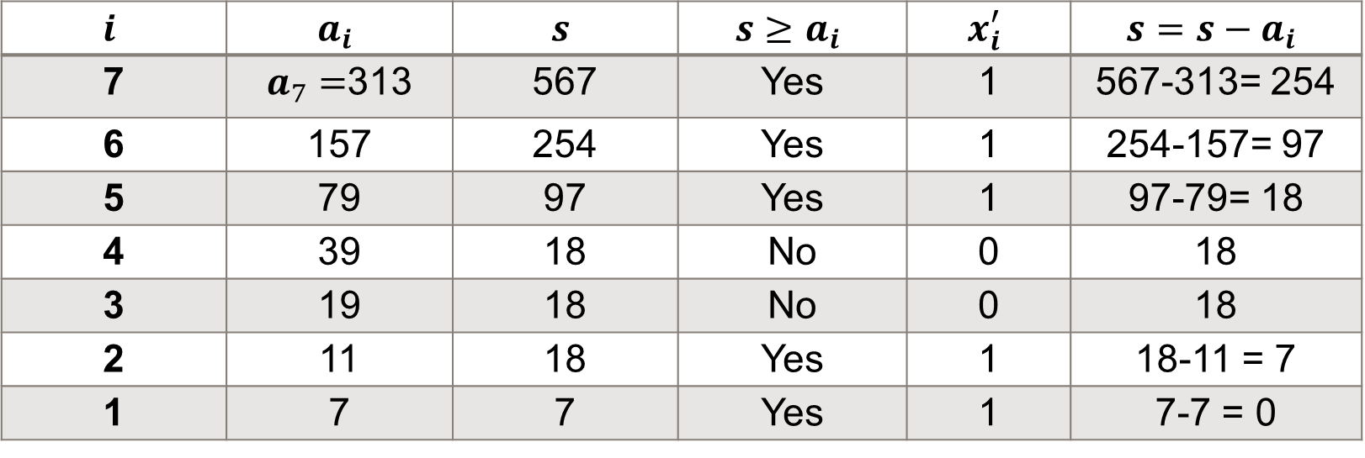

Knapsack cryptosystem – example
Decryption:
Bob receives $s=2079$ and computes $s^{′}≡2079⋅{37}^{−1}≡2079⋅73≡567 \left(mod 900\right)$
Next, Bob computes $x^{′}=inv_knapsackSum\left(s^{′},b\right)$:
$b=\left[7,11,19,39,79,157,313\right]$.
$$i$$ | $$a_{i}$$ | $$s$$ | $$s≥a_{i}$$ | $$x_{i}^{′}$$ | $$s=s−a_{i}$$
7 | $a_{7}=$313 | 567 | Yes | 1 | 567-313= 254
6 | 157 | 254 | Yes | 1 | 254-157= 97
5 | 79 | 97 | Yes | 1 | 97-79= 18
4 | 39 | 18 | No | 0 | 18
3 | 19 | 18 | No | 0 | 18
2 | 11 | 18 | Yes | 1 | 18-11 = 7
1 | 7 | 7 | Yes | 1 | 7-7 = 0

Slide 29

Knapsack cryptosystem – example
The inverse knapsack algorithm returns $x^{′}=\left[1,1,0,0,1,1,1\right].$
Bob computes permutation, $x=Per\left(x^{′}\right)=\left[1,1,0,0,1,1,1\right]$
Finally, Bob revert the string ${\left(1100111\right)}_{2}=g$ using ASCII code.

Slide 30
Knapsack cryptosystem – security
The underlying security behind the Knapsack Cryptosystem is based on the difficulty of solving the Knapsack Problem.
Knapsack Problem is one of the NP-Complete problems that has NO feasible algorithm to solve it currently.
Unfortunately, the Knapsack cryptosystem was broken by Adi Shamir in 1984. Hence, it is insecure and no longer be used.

Slide 31
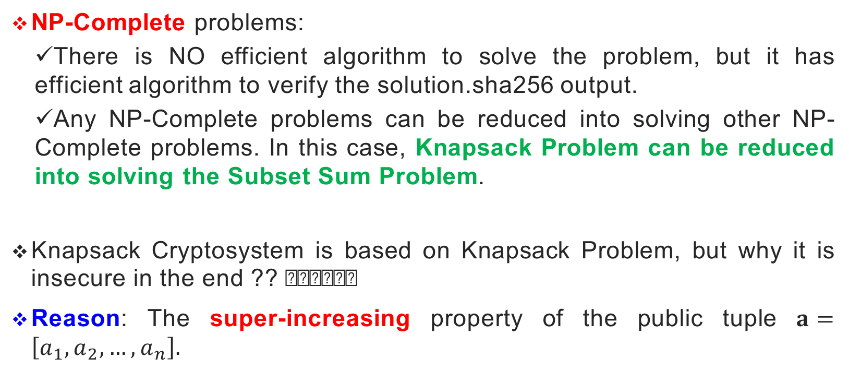
What is NP-Complete?
NP-Complete problems:
There is NO efficient algorithm to solve the problem, but it has efficient algorithm to verify the solution.sha256 output.
Any NP-Complete problems can be reduced into solving other NP-Complete problems. In this case, Knapsack Problem can be reduced into solving the Subset Sum Problem.
Knapsack Cryptosystem is based on Knapsack Problem, but why it is insecure in the end ?? 🤔🤔🤔
Reason: The super-increasing property of the public tuple $a=\left[a_{1},a_{2},…,a_{n}\right].$

Slide 32
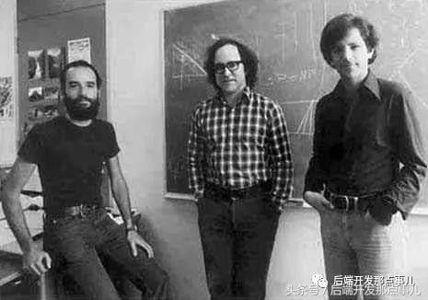
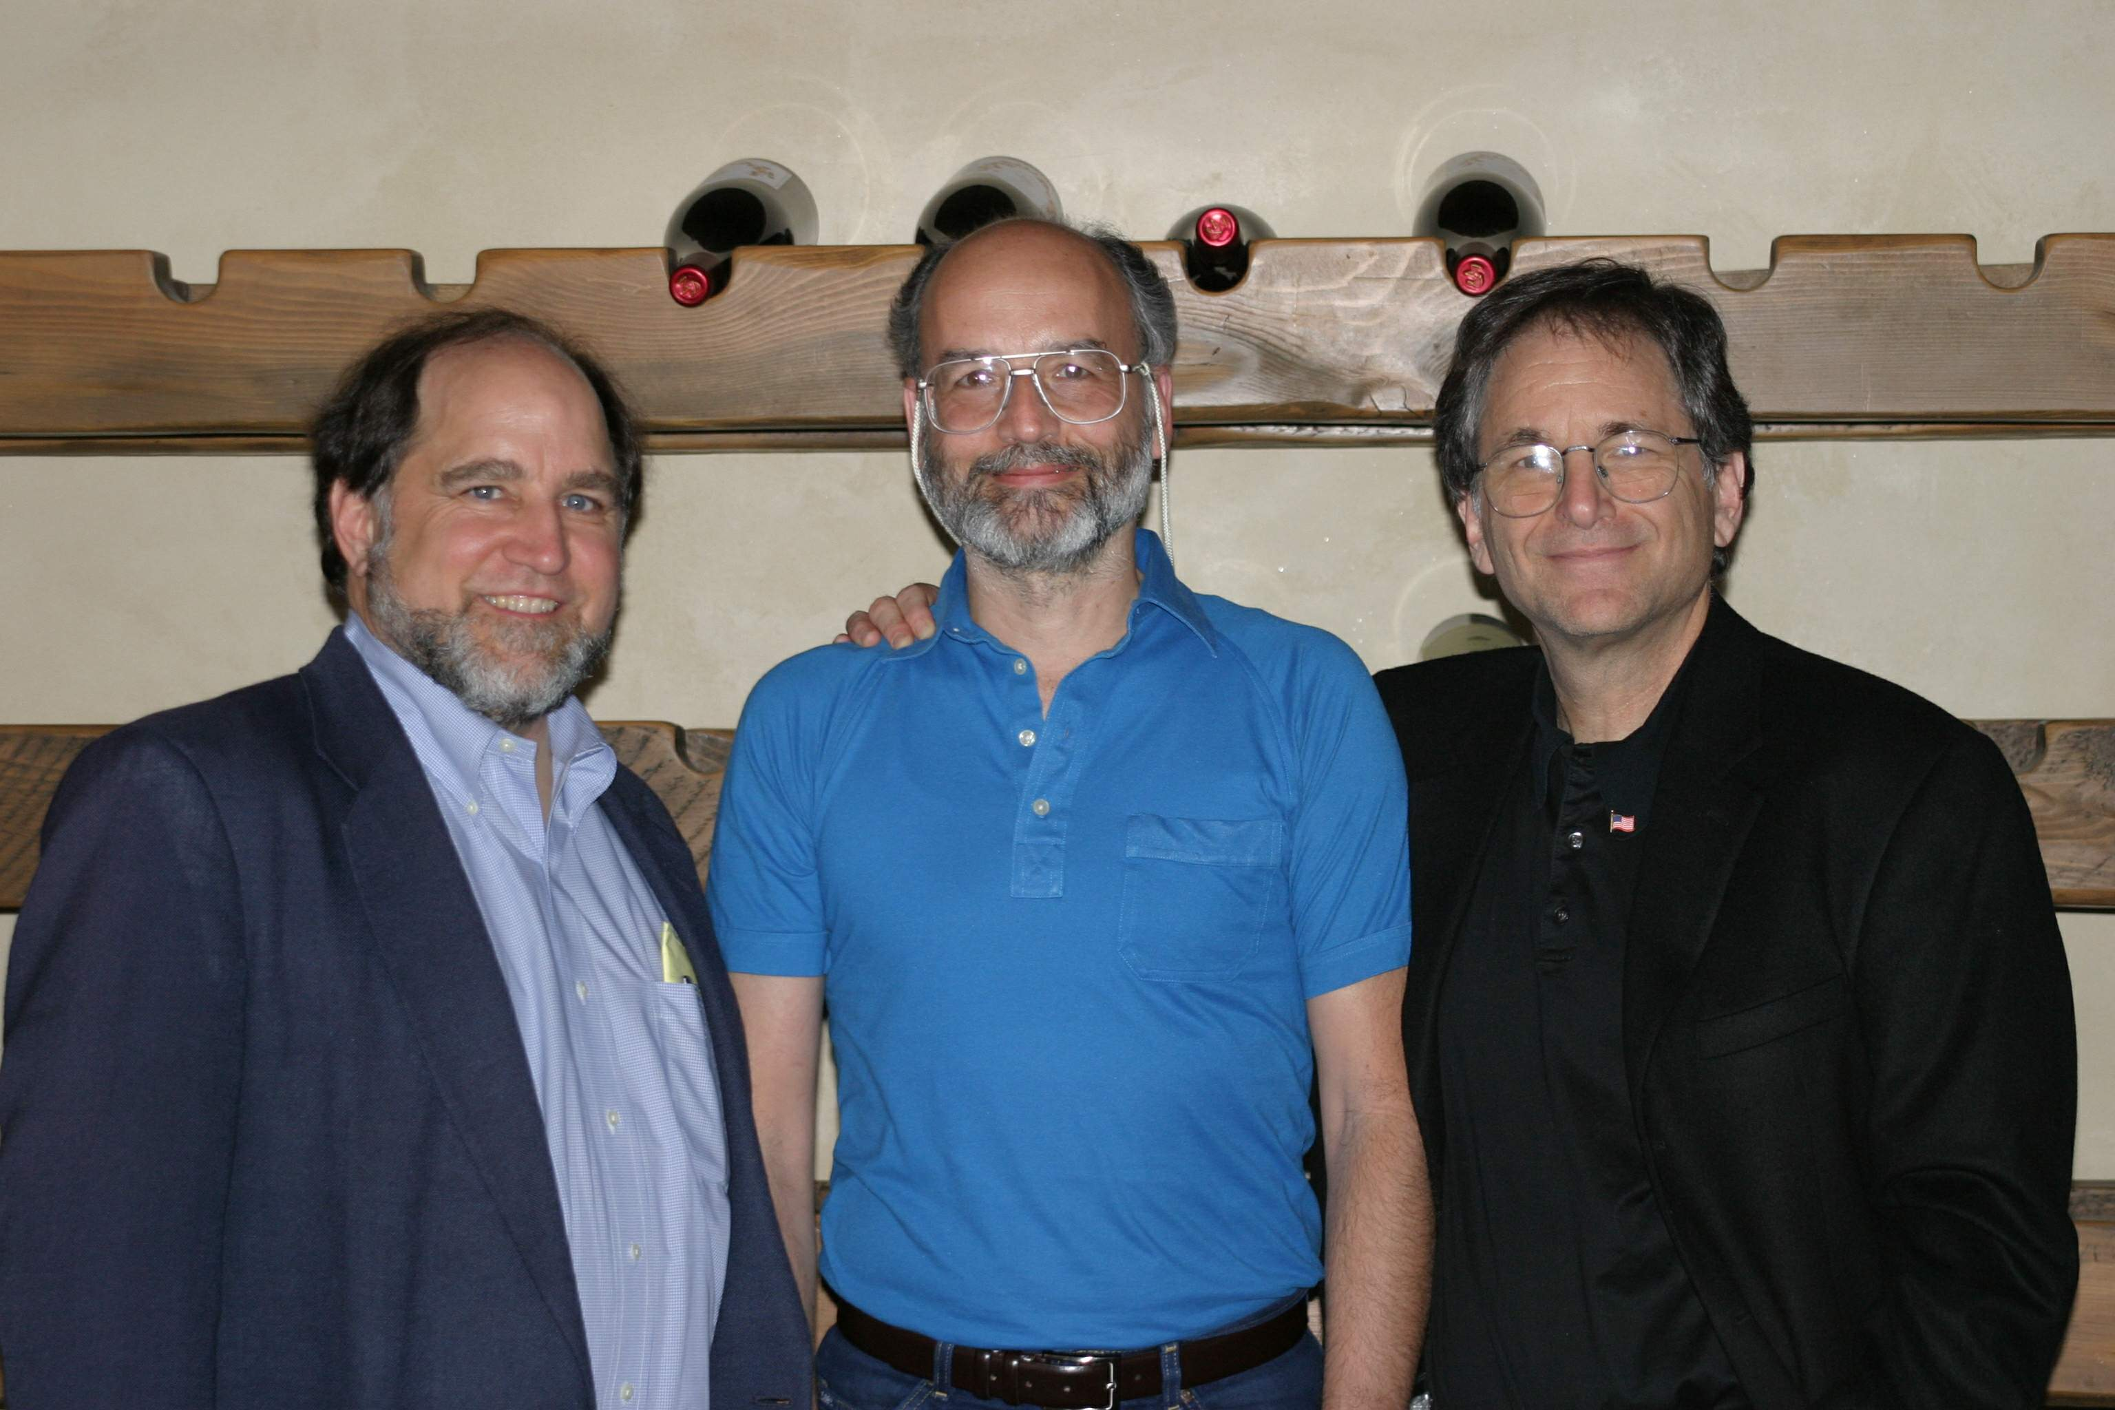
RSA (RIVEST-SHAMIR-ADLEMAN) cryptosystem

Slide 33
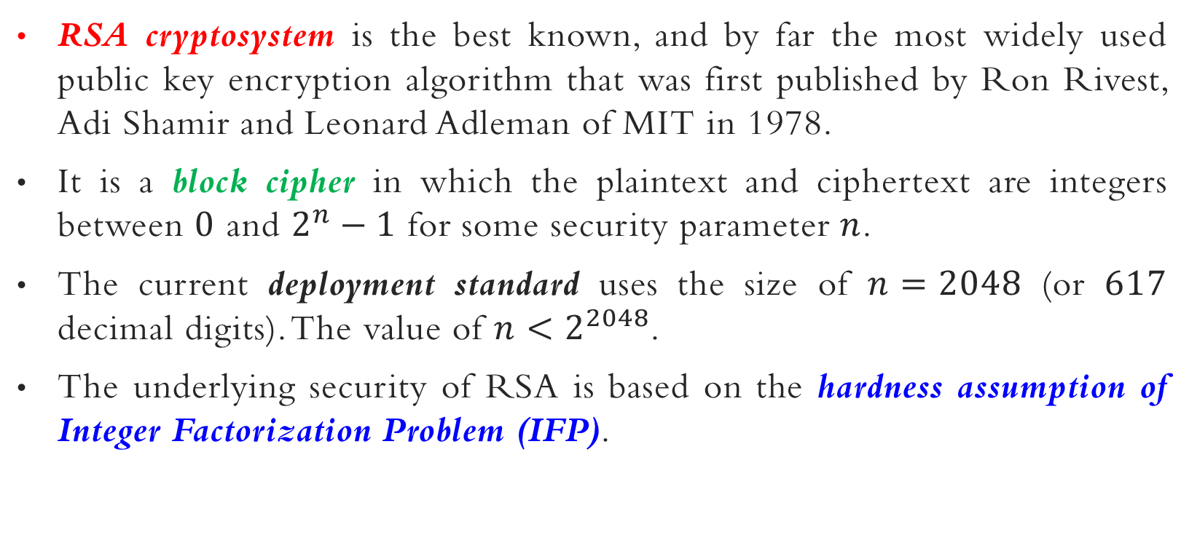
RSA CRYPTOSYSTEM
RSA cryptosystem is the best known, and by far the most widely used public key encryption algorithm that was first published by Ron Rivest, Adi Shamir and Leonard Adleman of MIT in 1978.
It is a block cipher in which the plaintext and ciphertext are integers between $0$ and $2^{n}−1$ for some security parameter $n$.
The current deployment standard uses the size of $n=2048$ (or $617$ decimal digits). The value of $n<2^{2048}$.
The underlying security of RSA is based on the hardness assumption of Integer Factorization Problem (IFP).

Slide 34
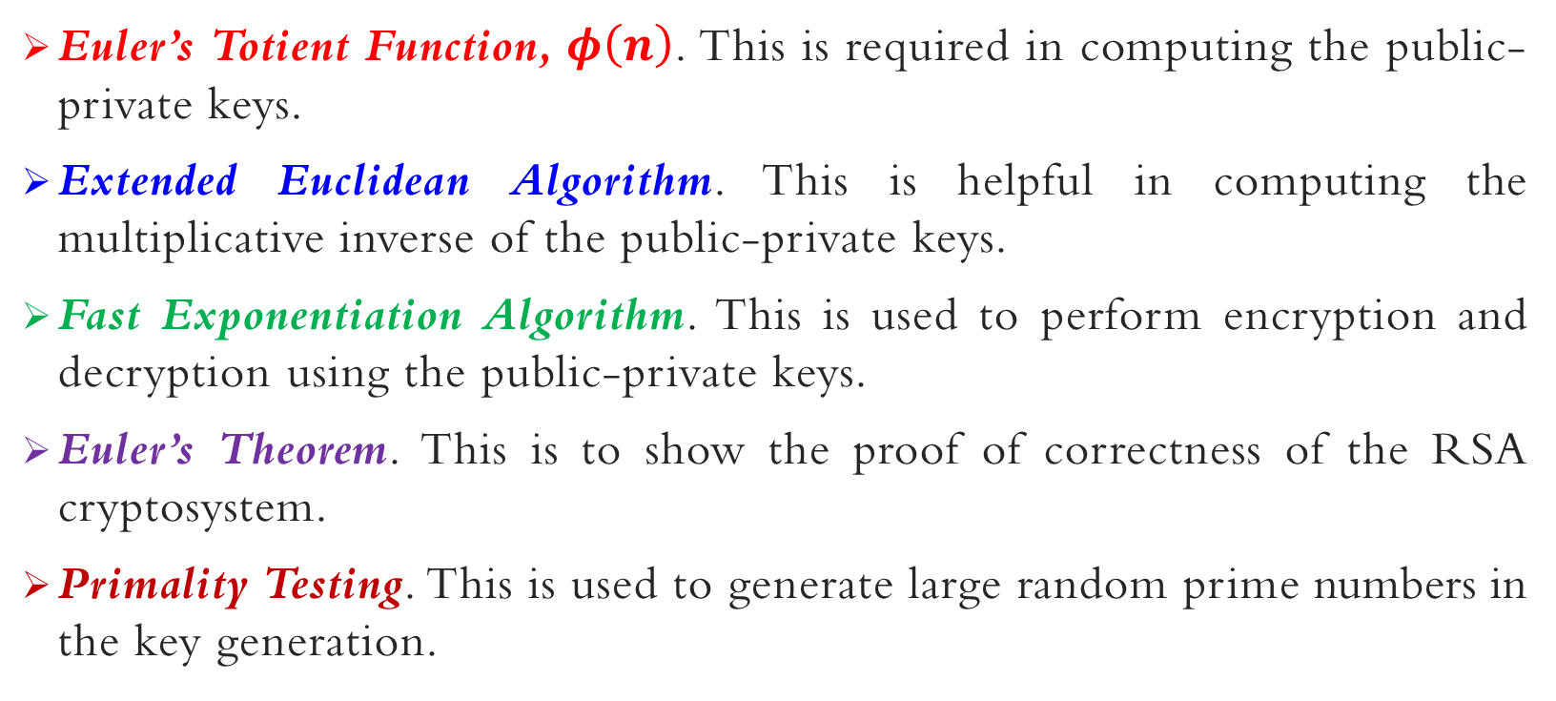
RSA CRYPTOSYSTEM – mathematics
Euler’s Totient Function, $φ\left(n\right)$. This is required in computing the public-private keys.
Extended Euclidean Algorithm. This is helpful in computing the multiplicative inverse of the public-private keys.
Fast Exponentiation Algorithm. This is used to perform encryption and decryption using the public-private keys.
Euler’s Theorem. This is to show the proof of correctness of the RSA cryptosystem.
Primality Testing. This is used to generate large random prime numbers in the key generation.

Slide 35
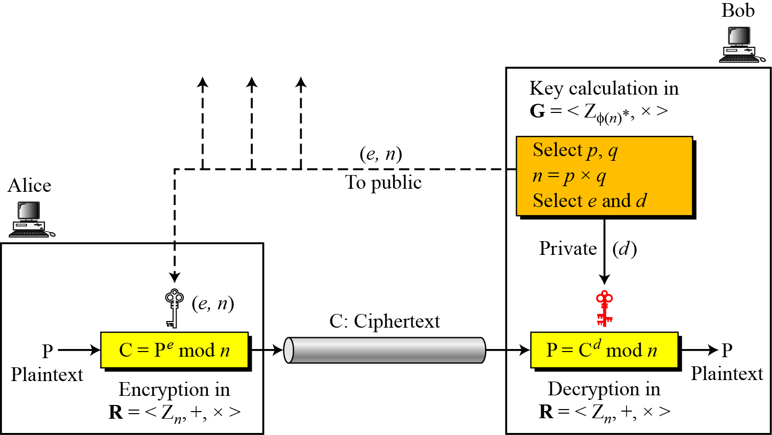
RSA CRYPTOSYSTEM - Overview

Slide 36
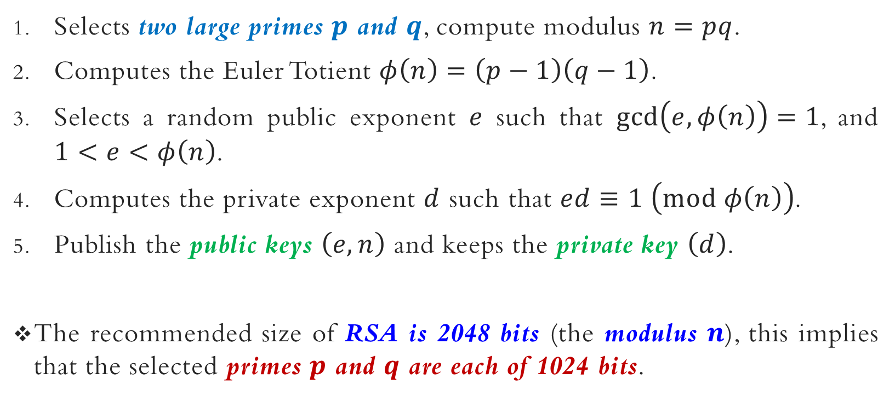
RSA CRYPTOSYSTEM – KEY GENERATION
Selects two large primes $p$ and $q$, compute modulus $n=pq$.
Computes the Euler Totient $φ\left(n\right)=\left(p−1\right)\left(q−1\right)$.
Selects a random public exponent $e$ such that $\gcd\left(e,φ\left(n\right)\right)=1$, and $1<e<φ\left(n\right)$.
Computes the private exponent $d$ such that $ed≡1 \left(mod φ\left(n\right)\right)$.
Publish the public keys $\left(e,n\right)$ and keeps the private key $\left(d\right)$.
The recommended size of RSA is 2048 bits (the modulus $n$), this implies that the selected primes $p$ and $q$ are each of 1024 bits.

Slide 37
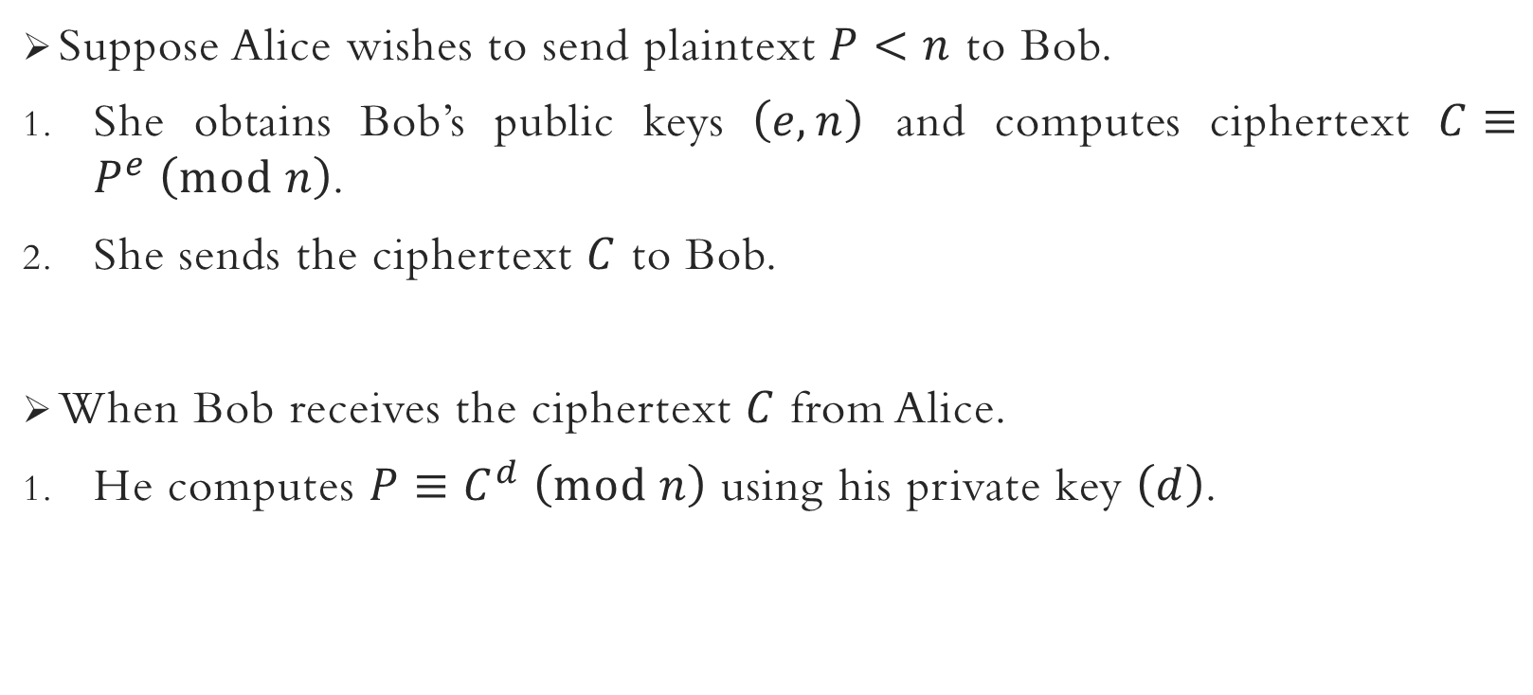
RSA CRYPTOSYSTEM – encryption & decryption
Suppose Alice wishes to send plaintext $P<n$ to Bob.
She obtains Bob’s public keys $\left(e,n\right)$ and computes ciphertext $C≡P^{e} \left(mod n\right)$.
She sends the ciphertext $C$ to Bob.
When Bob receives the ciphertext $C$ from Alice.
He computes $P≡C^{d} \left(mod n\right)$ using his private key $\left(d\right)$.

Slide 38

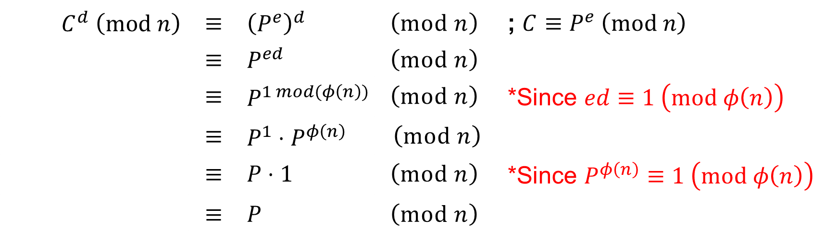
RSA CRYPTOSYSTEM – encryption & decryption
${\left(P^{encrypt}\right)}^{decrypt}$
Why is the encryption and decryption possible in RSA cryptosystem?
Proof of correctness.
$C^{d} \left(mod n\right)$ | $≡$ | ${\left(P^{e}\right)}^{d}$ | $$\left(mod n\right)$$ | ; $C≡P^{e} \left(mod n\right)$
 | $≡$ | $P^{ed}$ | $$\left(mod n\right)$$
 | $≡$ | $P^{1 mod(φ\left(n\right))}$ | $$\left(mod n\right)$$ | *Since $ed≡1 \left(mod φ\left(n\right)\right)$
 | $≡$ | $P^{1}⋅P^{φ\left(n\right)}$ | $$\left(mod n\right)$$
 | $≡$ | $P⋅1$ | $$\left(mod n\right)$$ | *Since $P^{φ\left(n\right)}≡1 \left(mod φ\left(n\right)\right)$
 | $≡$ | $P$ | $$\left(mod n\right)$$

Slide 39
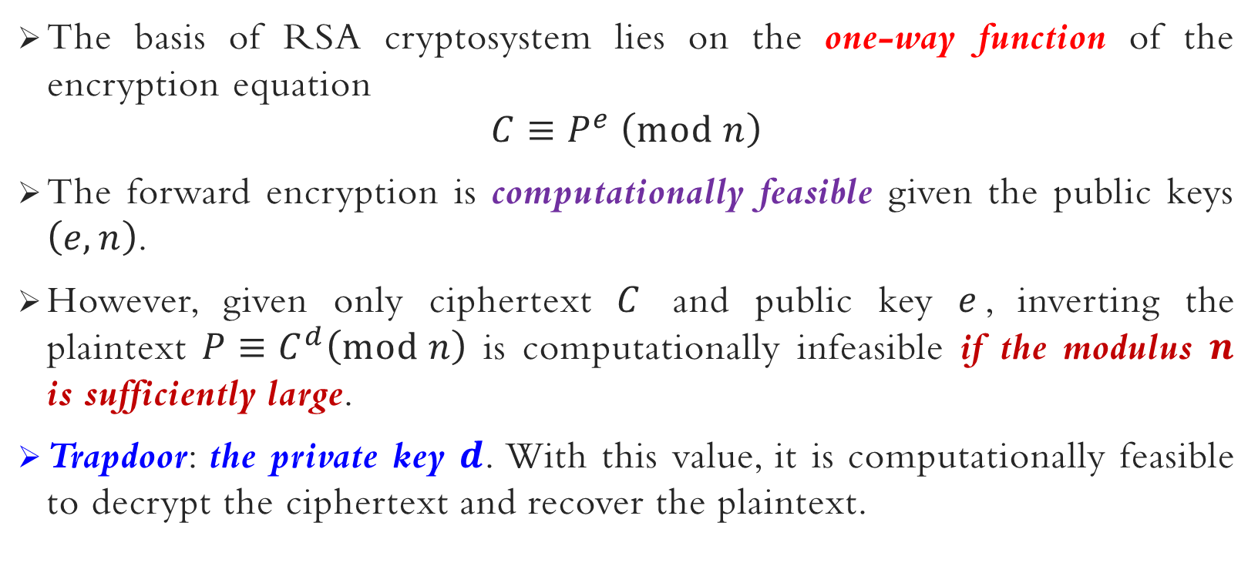
RSA CRYPTOSYSTEM – trapdoor one-way function
The basis of RSA cryptosystem lies on the one-way function of the encryption equation
$$C≡P^{e} \left(mod n\right)$$
The forward encryption is computationally feasible given the public keys $\left(e,n\right)$.
However, given only ciphertext $C$ and public key $e$, inverting the plaintext $P≡C^{d}\left(mod n\right)$ is computationally infeasible if the modulus $n$ is sufficiently large.
Trapdoor: the private key $d$. With this value, it is computationally feasible to decrypt the ciphertext and recover the plaintext.

Slide 40
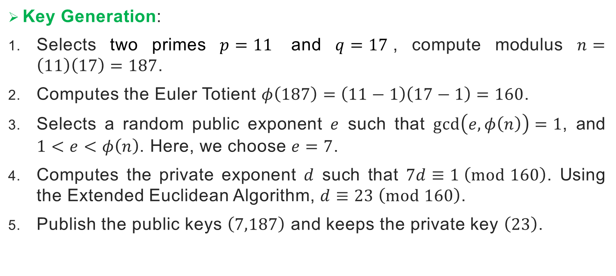
RSA CRYPTOSYSTEM – small example
Key Generation:
Selects two primes $p=11$ and $q=17$, compute modulus $n=\left(11\right)\left(17\right)=187$.
Computes the Euler Totient $φ\left(187\right)=\left(11−1\right)\left(17−1\right)=160$.
Selects a random public exponent $e$ such that $\gcd\left(e,φ\left(n\right)\right)=1$, and $1<e<φ\left(n\right)$. Here, we choose $e=7$.
Computes the private exponent $d$ such that $7d≡1 \left(mod 160\right)$. Using the Extended Euclidean Algorithm, $d≡23 \left(mod 160\right)$.
Publish the public keys $\left(7,187\right)$ and keeps the private key $\left(23\right)$.

Slide 41
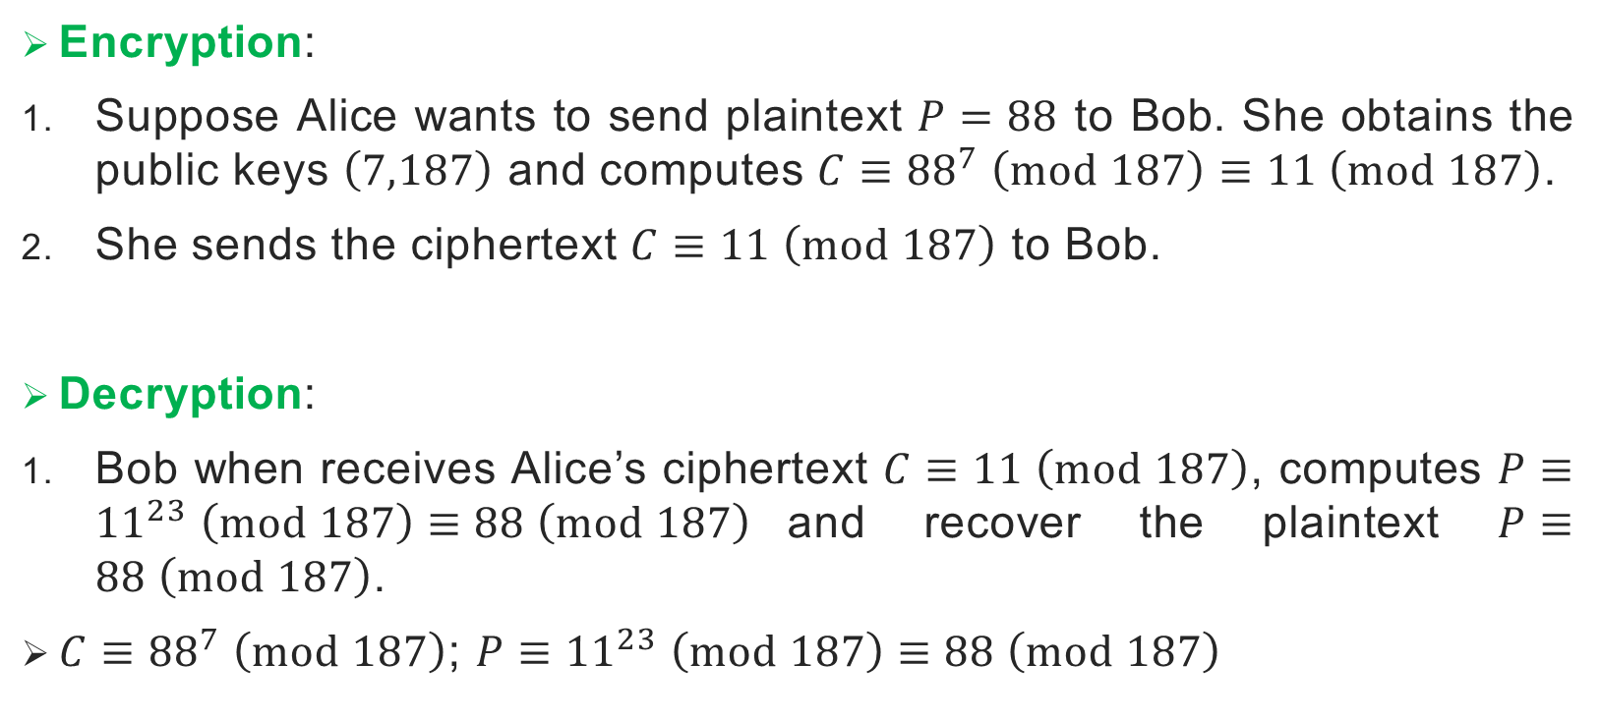
RSA CRYPTOSYSTEM – small example
Encryption:
Suppose Alice wants to send plaintext $P=88$ to Bob. She obtains the public keys $\left(7,187\right)$ and computes $C≡{88}^{7} \left(mod 187\right)≡11 \left(mod 187\right)$.
She sends the ciphertext $C≡11 \left(mod 187\right)$ to Bob.
Decryption:
Bob when receives Alice’s ciphertext $C≡11 \left(mod 187\right)$, computes $P≡{11}^{23} \left(mod 187\right)≡88 \left(mod 187\right)$and recover the plaintext $P≡88 \left(mod 187\right)$.
$C≡{88}^{7} \left(mod 187\right)$; $P≡{11}^{23} \left(mod 187\right)≡88 \left(mod 187\right)$

Slide 42
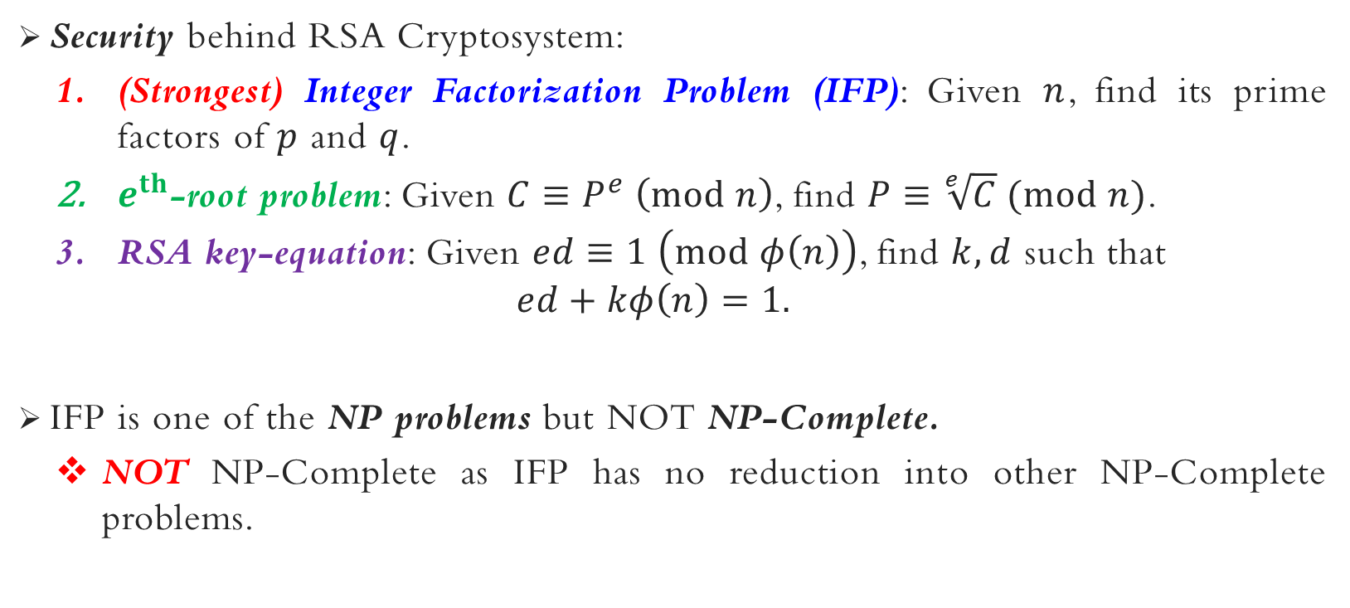
RSA CRYPTOSYSTEM – security
Security behind RSA Cryptosystem:
(Strongest) Integer Factorization Problem (IFP): Given $n$, find its prime factors of $p$ and $q$.
$e^{th}$-root problem: Given $C≡P^{e} \left(mod n\right)$, find $P≡\sqrt[e]{C} (mod n)$.
RSA key-equation: Given $ed≡1 \left(mod φ\left(n\right)\right)$, find $k,d$ such that
$$ed+kφ\left(n\right)=1.$$
IFP is one of the NP problems but NOT NP-Complete.
NOT NP-Complete as IFP has no reduction into other NP-Complete problems.

Slide 43

Integer Factorization Problem (IFP):
n = 17,408,604,539 = pq
$φ\left(n\right)$= 17,408,340,120 = (p-1)(q-1)
Find p & q
Can you find $\sqrt[168]{C}$
$ed≡1 \left(mod φ\left(n\right)\right) , e=7, n=187, ,φ\left(n\right)$= 160
Find $k and d, where ed+kφ\left(n\right)=1.$

Slide 44
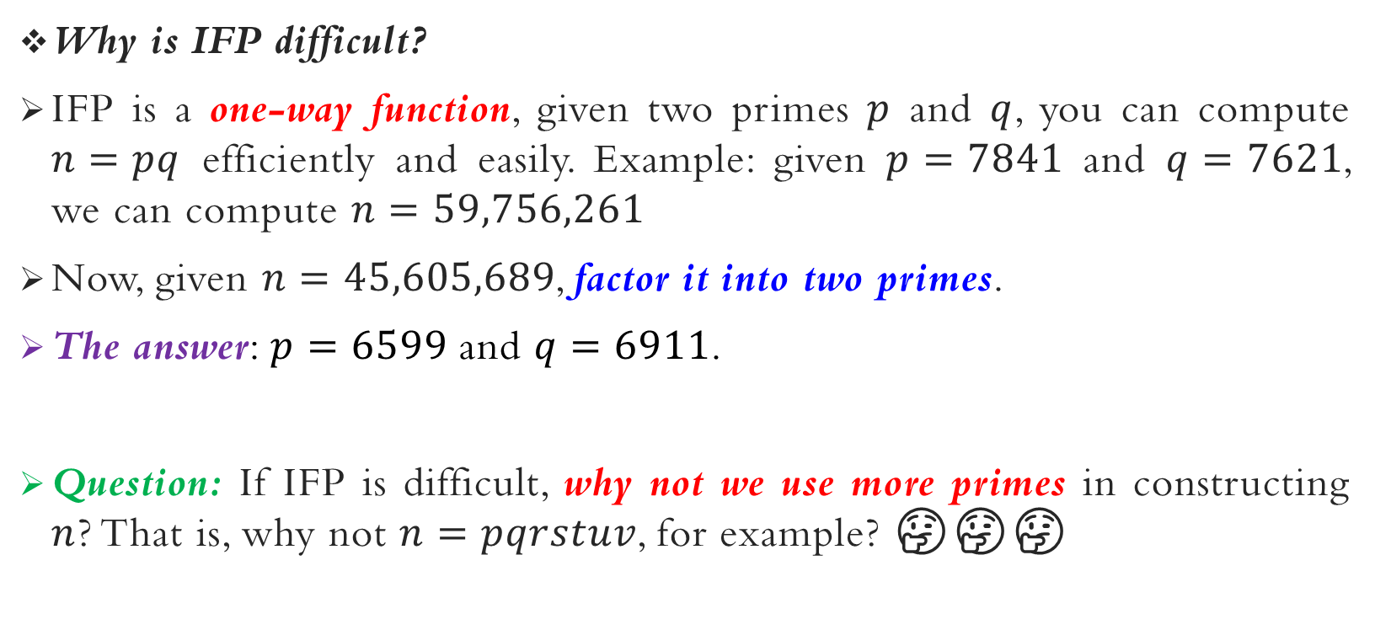
RSA CRYPTOSYSTEM – security
Why is IFP difficult?
IFP is a one-way function, given two primes $p$ and $q$, you can compute $n=pq$ efficiently and easily. Example: given $p=7841$ and $q=7621$, we can compute $n=59,756,261$
Now, given $n=45,605,689$, factor it into two primes.
The answer: $p=6599$ and $q=6911$.
Question: If IFP is difficult, why not we use more primes in constructing $n$? That is, why not $n=pqrstuv$, for example? 🤔🤔🤔

Slide 45
RSA CRYPTOSYSTEM – cryptanalysis & attacks
There are generally five possible approaches to attacking RSA:
Brute Force
Mathematical Attacks
Timing Attacks
Hardware Fault-Based Attacks
Chosen Ciphertext Attacks (CCA)

Slide 46
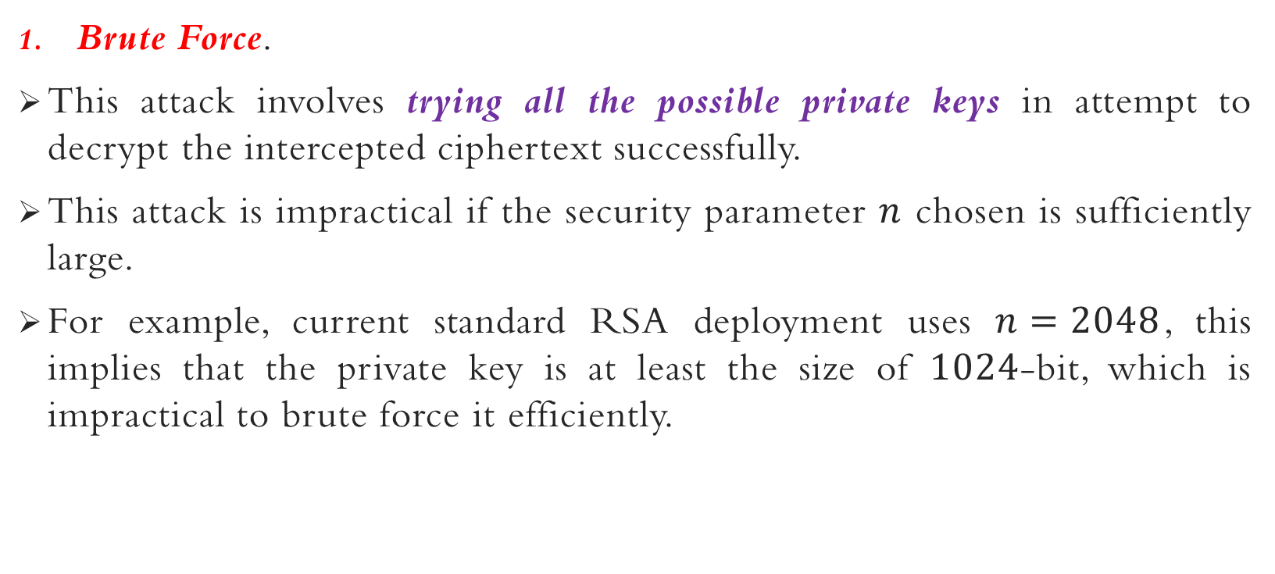
RSA CRYPTOSYSTEM – cryptanalysis & attacks
Brute Force.
This attack involves trying all the possible private keys in attempt to decrypt the intercepted ciphertext successfully.
This attack is impractical if the security parameter $n$ chosen is sufficiently large.
For example, current standard RSA deployment uses $n=2048$, this implies that the private key is at least the size of $1024$-bit, which is impractical to brute force it efficiently.

Slide 47
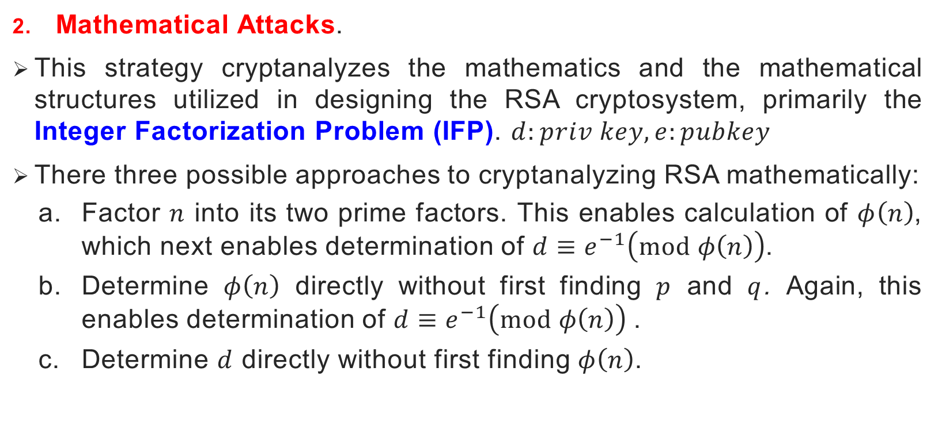
RSA CRYPTOSYSTEM – cryptanalysis & attacks
Mathematical Attacks.
This strategy cryptanalyzes the mathematics and the mathematical structures utilized in designing the RSA cryptosystem, primarily the Integer Factorization Problem (IFP). $d:priv key, e:pubkey$
There three possible approaches to cryptanalyzing RSA mathematically:
Factor $n$ into its two prime factors. This enables calculation of $φ\left(n\right)$, which next enables determination of $d≡e^{−1}\left(mod φ\left(n\right)\right)$.
Determine $φ\left(n\right)$ directly without first finding $p$ and $q$. Again, this enables determination of $d≡e^{−1}\left(mod φ\left(n\right)\right)$.
Determine $d$ directly without first finding $φ\left(n\right)$.

Slide 48
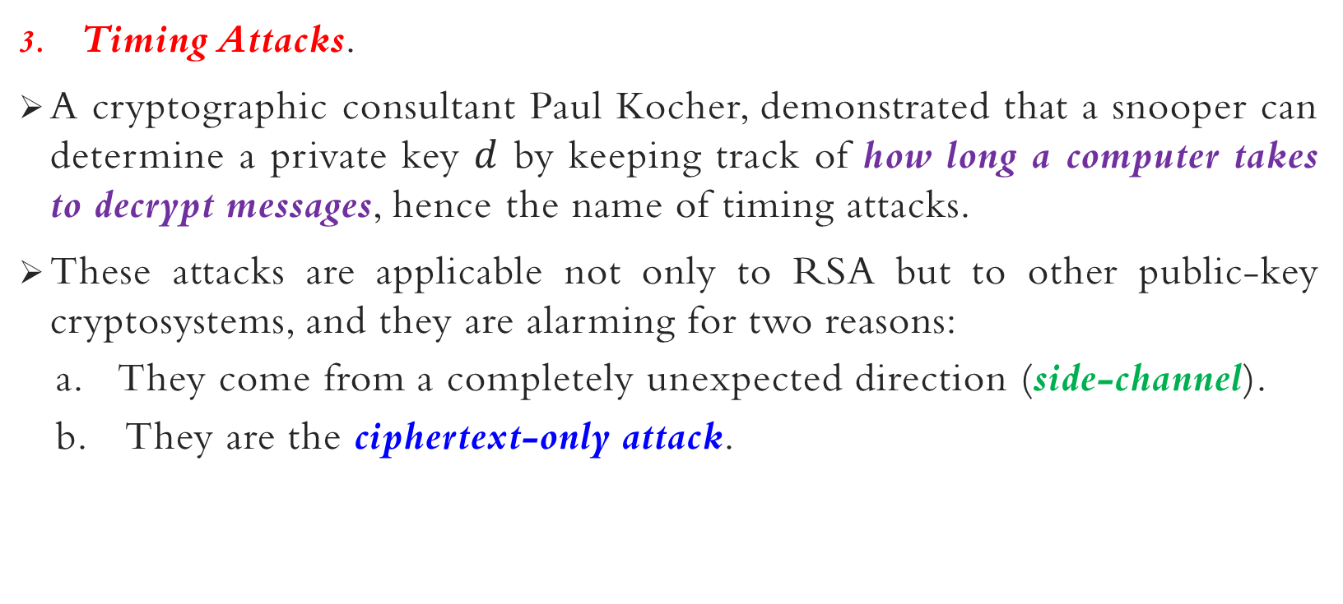
RSA CRYPTOSYSTEM – cryptanalysis & attacks
Timing Attacks.
A cryptographic consultant Paul Kocher, demonstrated that a snooper can determine a private key $d$ by keeping track of how long a computer takes to decrypt messages, hence the name of timing attacks.
These attacks are applicable not only to RSA but to other public-key cryptosystems, and they are alarming for two reasons:
They come from a completely unexpected direction (side-channel).
They are the ciphertext-only attack.
If exponent is small,
Time is small.
$C≡{88}^{7} \left(mod 187\right)$; $P≡{11}^{23} \left(mod 187\right)≡88 \left(mod 187\right)$

Slide 49
RSA CRYPTOSYSTEM – cryptanalysis & attacks
To prevent such timing attacks, some countermeasures can be taken:
Constant exponentiation time. Ensures that all exponentiations take the same amount of time before returning a result; this is a simple fix, but it degrades the performance.
Random delay. Better performance could be achieved by adding a random delay to the exponentiation algorithm to confuse the timing attack.
Blinding. Multiply the ciphertext by a random number before performing an exponentiation. This process prevents the attacker from knowing what ciphertext bits are being processed inside the computer and therefore prevents the bit-by-bit analysis essential to the timing attack.

Slide 50
RSA CRYPTOSYSTEM – cryptanalysis & attacks
Hardware Fault-Based Attacks.
An attack on a processor that is generating RSA digital signatures.
It induces faults in the signature computation by reducing the power to the processor.
The faults cause the software to produce invalid signatures which can then be analyzed by the attacker to recover the private key.
The attack algorithm involves inducing single-bit errors and observing the results.
While worthy of consideration, this attack does not appear to be a serious threat to RSA since it requires that the attacker to have physical access to the target machine and is able to directly control the input power to the processor.

Slide 51
RSA CRYPTOSYSTEM – cryptanalysis & attacks
Chosen Ciphertext Attack (CCA).
The strongest cryptanalysis environment where an attacker has the full ability to simulate the ciphertexts of his choice and is then given the corresponding decrypted plaintexts.
The adversary exploits properties of RSA and selects blocks of data that, when processed using the target’s private key, yield information needed for cryptanalysis.
To counter such attacks, RSA Security Inc. recommends modifying the plaintext using a procedure known as optimal asymmetric encryption padding (OAEP).
How U encrypt ? U use public key (known to everyone).
Encrypt anything with any text, U will get the cipher text for your plaintext.

Slide 52
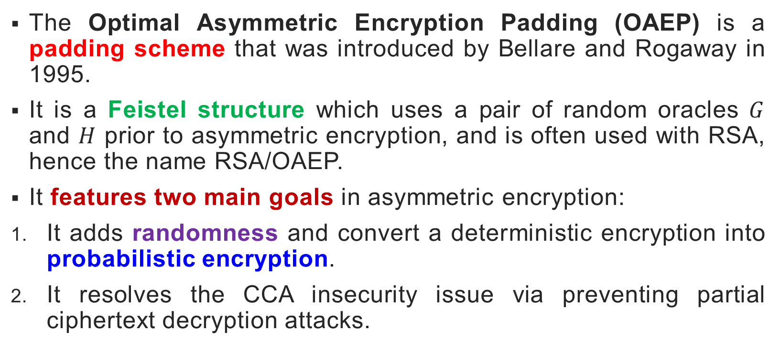
RSA optimal asymmetric encryption padding (RSA/oaep)
The Optimal Asymmetric Encryption Padding (OAEP) is a padding scheme that was introduced by Bellare and Rogaway in 1995.
It is a Feistel structure which uses a pair of random oracles $G$ and $H$ prior to asymmetric encryption, and is often used with RSA, hence the name RSA/OAEP.
It features two main goals in asymmetric encryption:
It adds randomness and convert a deterministic encryption into probabilistic encryption.
It resolves the CCA insecurity issue via preventing partial ciphertext decryption attacks.

Slide 53
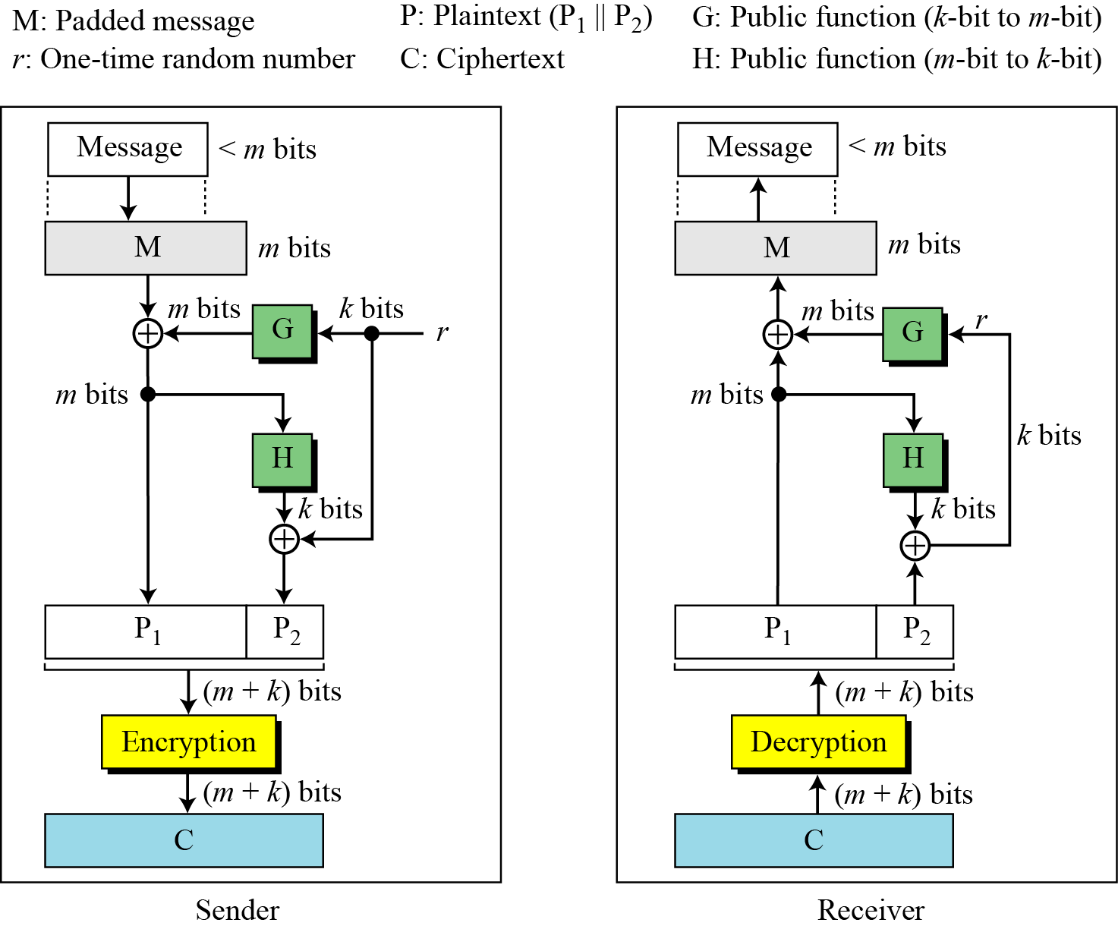

Slide 54
ELGAMAL cryptosystem (optional)

Slide 55
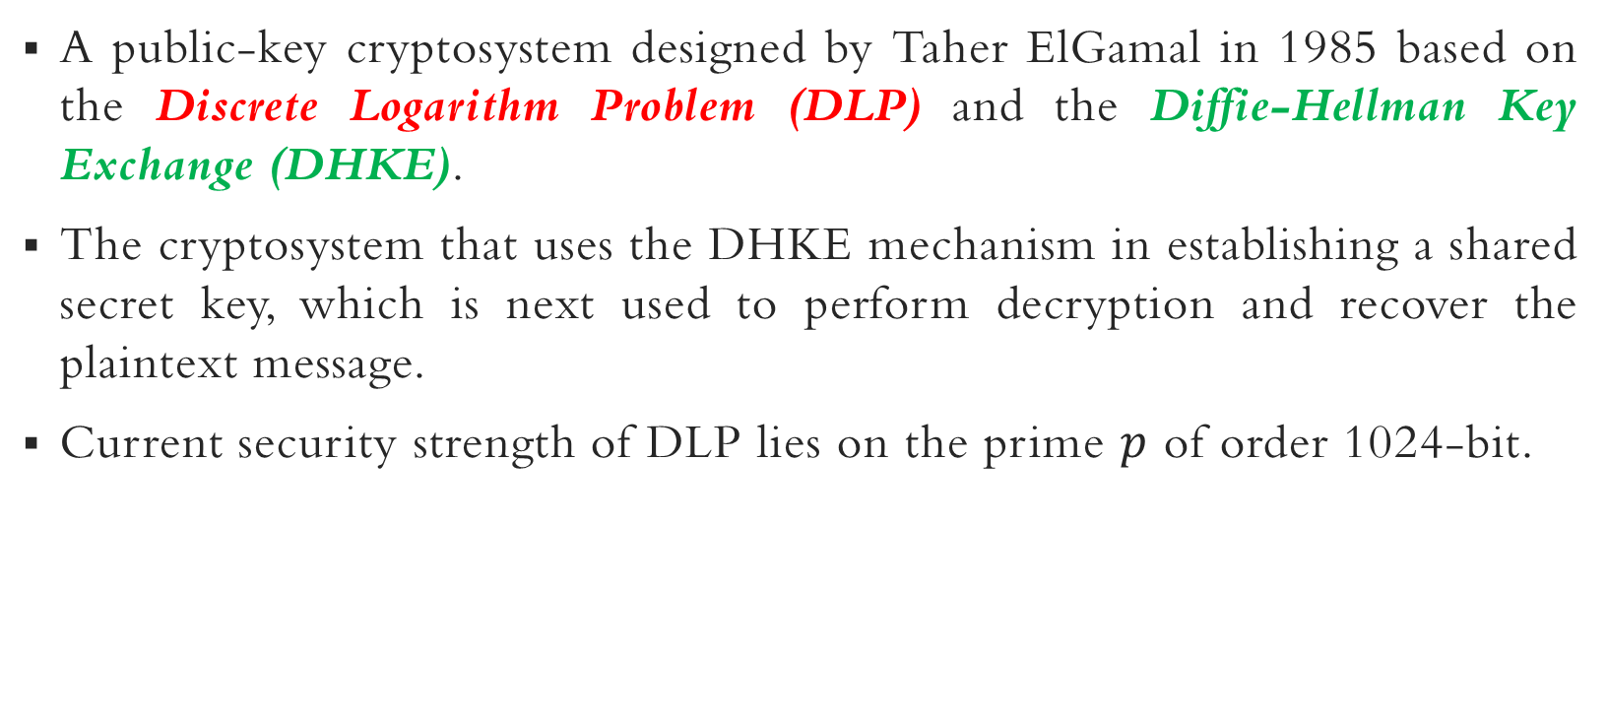
Elgamal cryptosystem
A public-key cryptosystem designed by Taher ElGamal in 1985 based on the Discrete Logarithm Problem (DLP) and the Diffie-Hellman Key Exchange (DHKE).
The cryptosystem that uses the DHKE mechanism in establishing a shared secret key, which is next used to perform decryption and recover the plaintext message.
Current security strength of DLP lies on the prime $p$ of order 1024-bit.

Slide 56
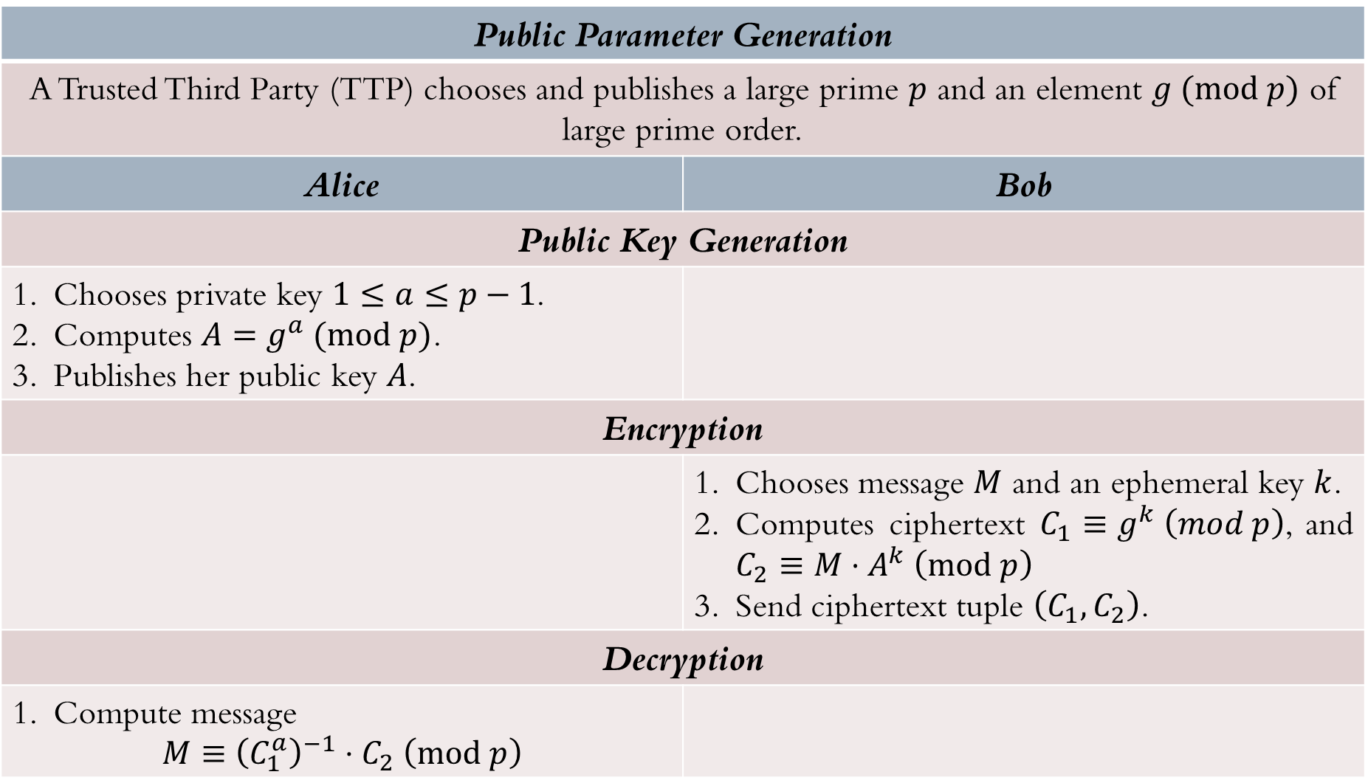
Public Parameter Generation
A Trusted Third Party (TTP) chooses and publishes a large prime $p$ and an element $g (mod p)$ of large prime order.
Alice | Bob
Public Key Generation
Chooses private key $1≤a≤p−1$. Computes $A=g^{a} (mod p)$. Publishes her public key $A$.
Encryption
 | Chooses message $M$ and an ephemeral key $k$. Computes ciphertext $C_{1}≡g^{k} \left(mod p\right)$, and $C_{2}≡M⋅A^{k} \left(mod p\right)$ Send ciphertext tuple $\left(C_{1},C_{2}\right)$.
Decryption
Compute message $$M≡{\left(C_{1}^{a}\right)}^{−1}⋅C_{2} \left(mod p\right)$$

Slide 57

Elgamal cryptosystem
Proof of correctness.
${\left(C_{1}^{a}\right)}^{−1}⋅C_{2}$ | $$≡$$ | ${\left(g^{ka}\right)}^{−1}⋅\left(M⋅A^{k}\right)$ | $$\left(mod p\right)$$
 | $$≡$$ | ${\left(g^{ak}\right)}^{−1}⋅\left(M⋅A^{k}\right)$ | $$\left(mod p\right)$$
 | $$≡$$ | ${\left(A^{k}\right)}^{−1}⋅\left(M⋅A^{k}\right)$ | $$\left(mod p\right)$$
 | $$≡$$ | $A^{−k}⋅\left(M⋅A^{k}\right)$ | $$\left(mod p\right)$$
 | $$≡$$ | $M$ | $$\left(mod p\right)$$

Slide 58
Main References for Chapter 9
Forouzan, B.A. “Introduction to Cryptography and Network Security”, Third Edition, McGraw-Hill, 2008.
Stallings, W. “Cryptography and Network Security: Principles and Practices”, Fifth Edition, Pearson Prentice Hall, 2011.

Slide 59
~ THE END ☺ ~

